Slide 1


Homomorphic Encryption
Prof Bill Buchanan OBE, Blockpass ID Lab
http://asecuritysite.com

Slide 2
FHE: 2. Background
Prof Bill Buchanan OBE, Blockpass ID Lab
http://asecuritysite.com

Slide 3
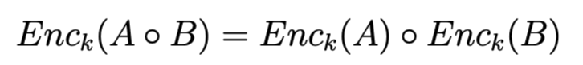
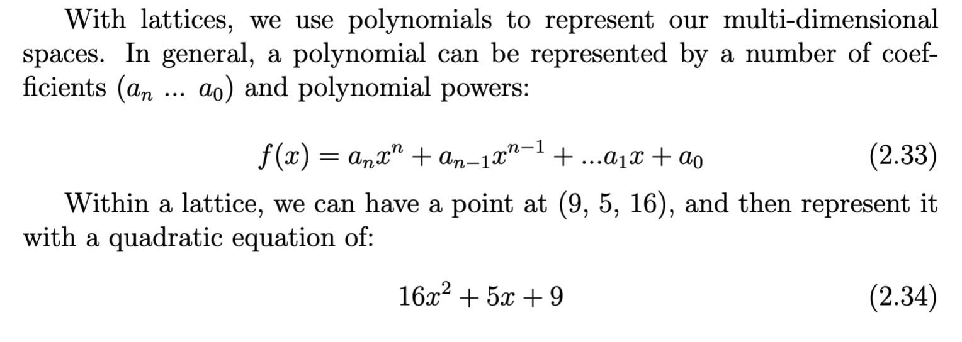
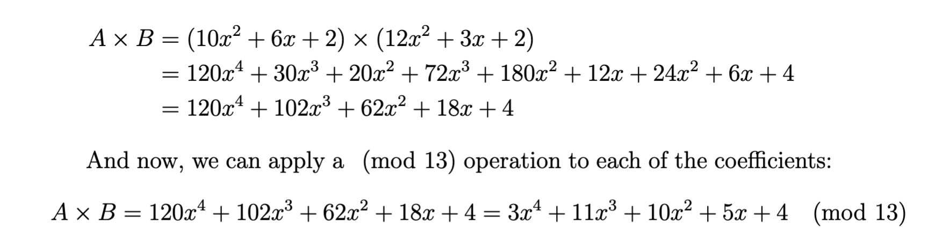
Polynomials

Slide 4
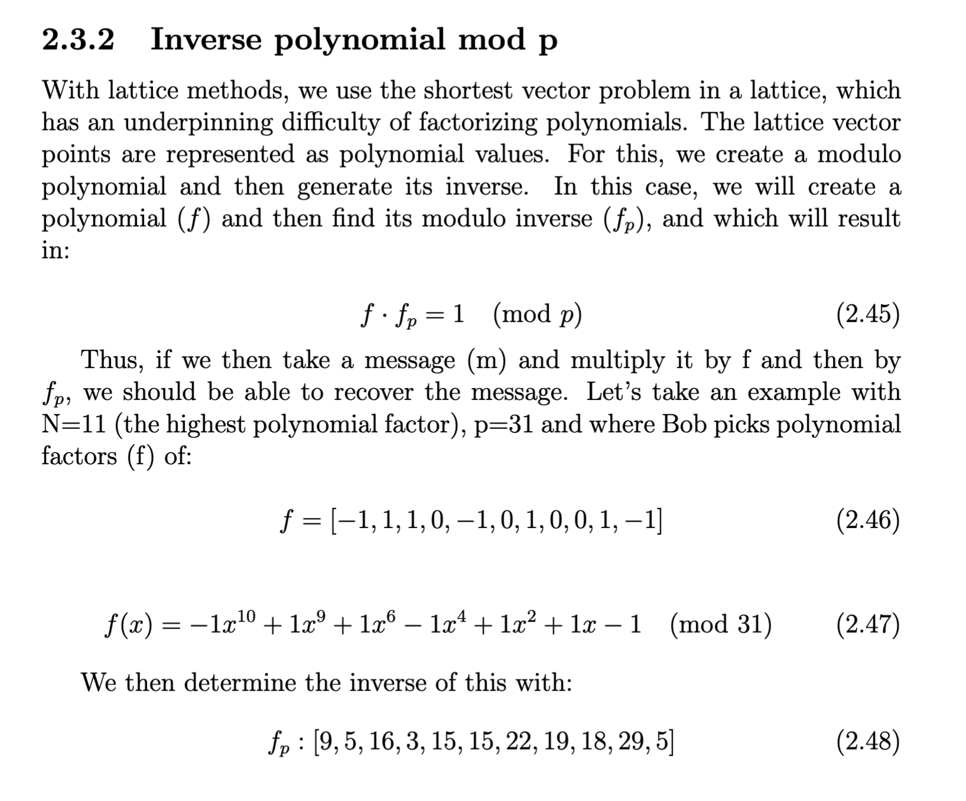
Inv Mod p

Slide 5
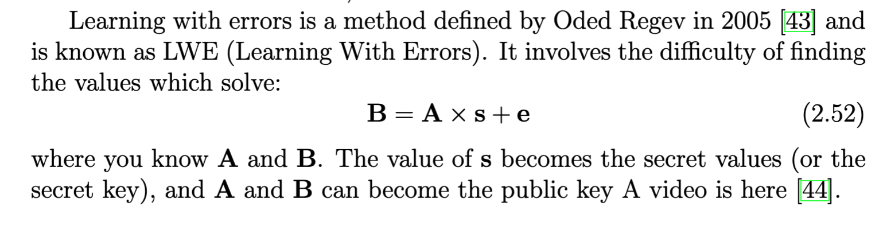
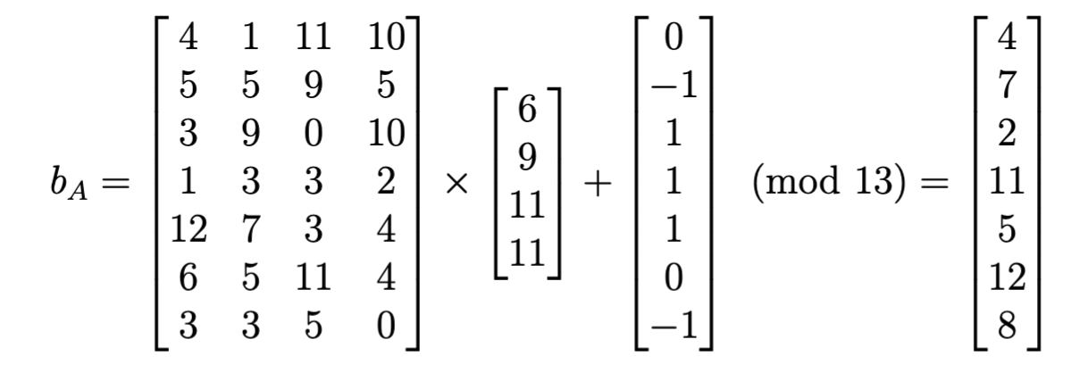
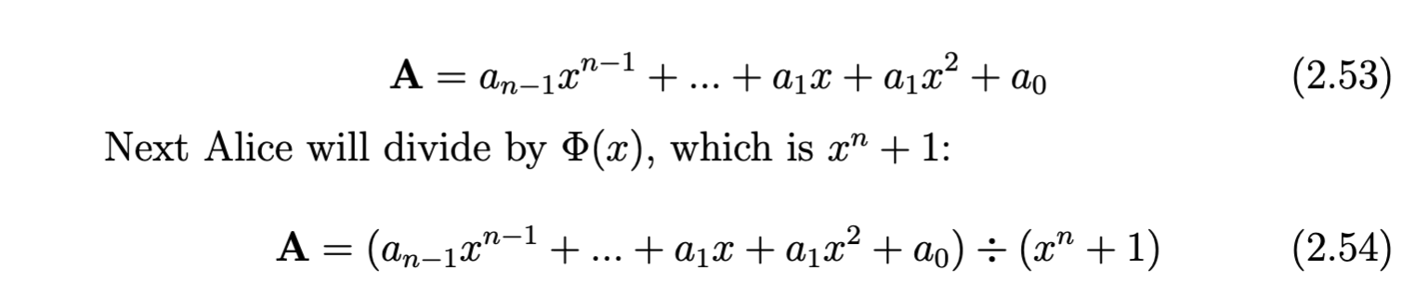
RLWE

Slide 6
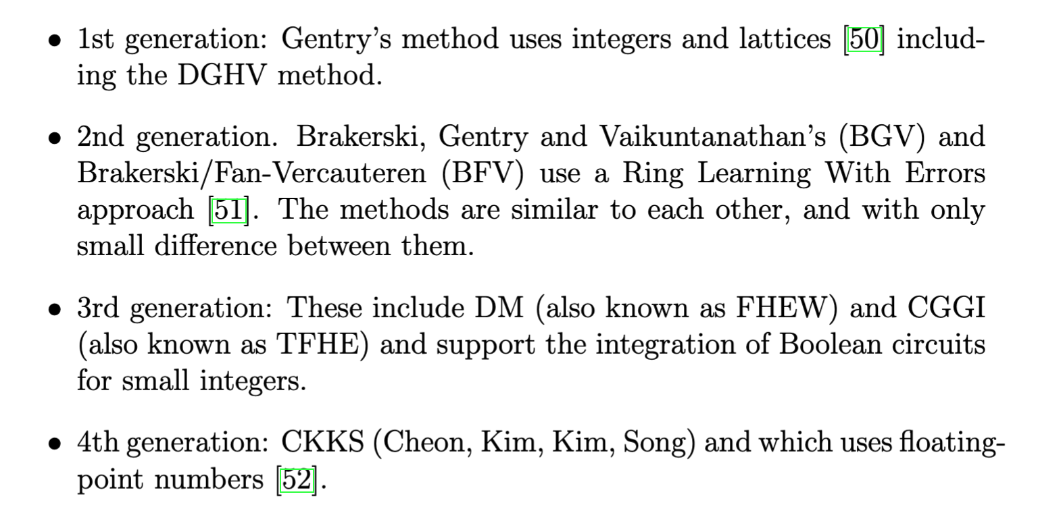
FHE

Slide 7
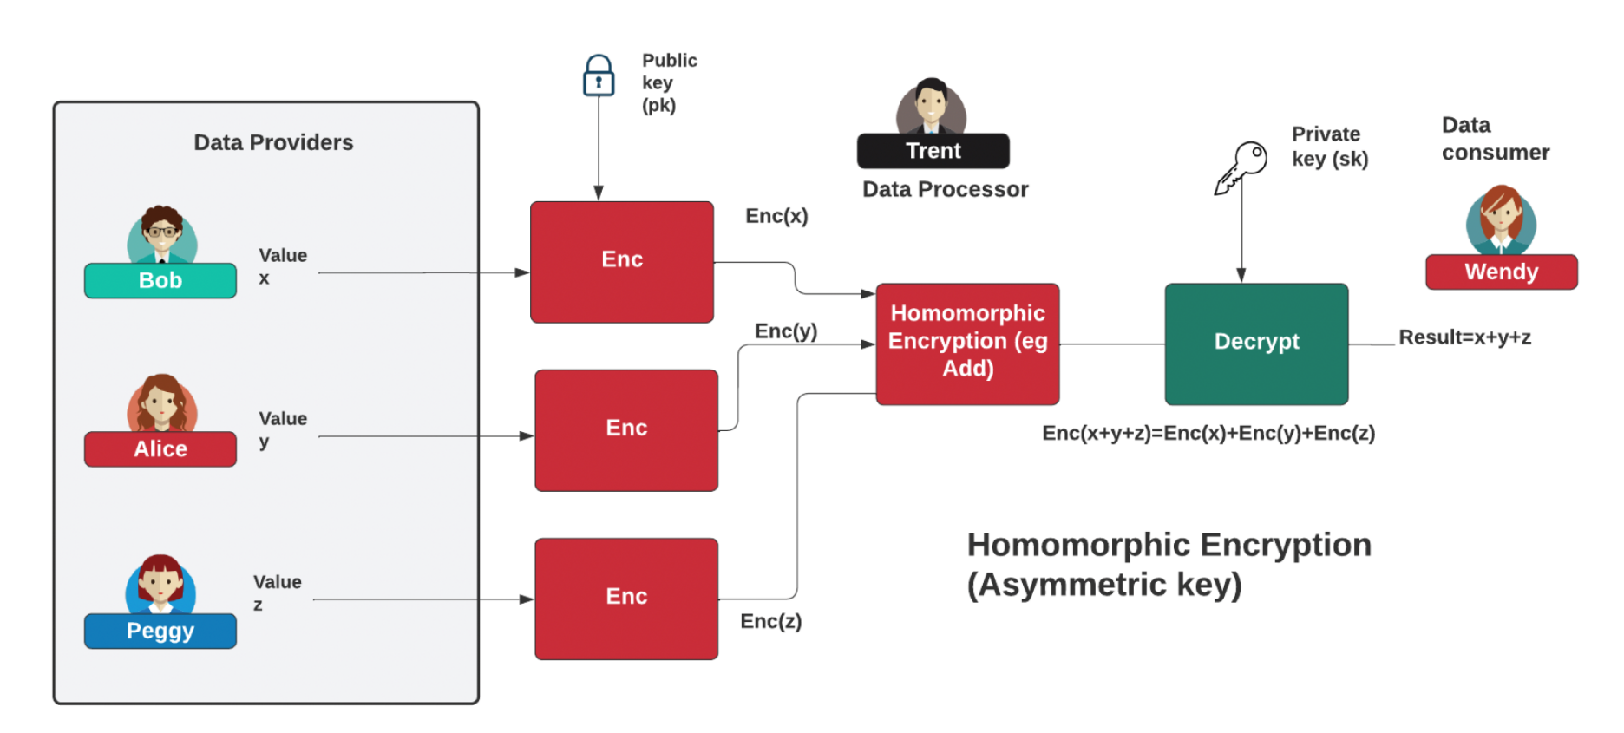
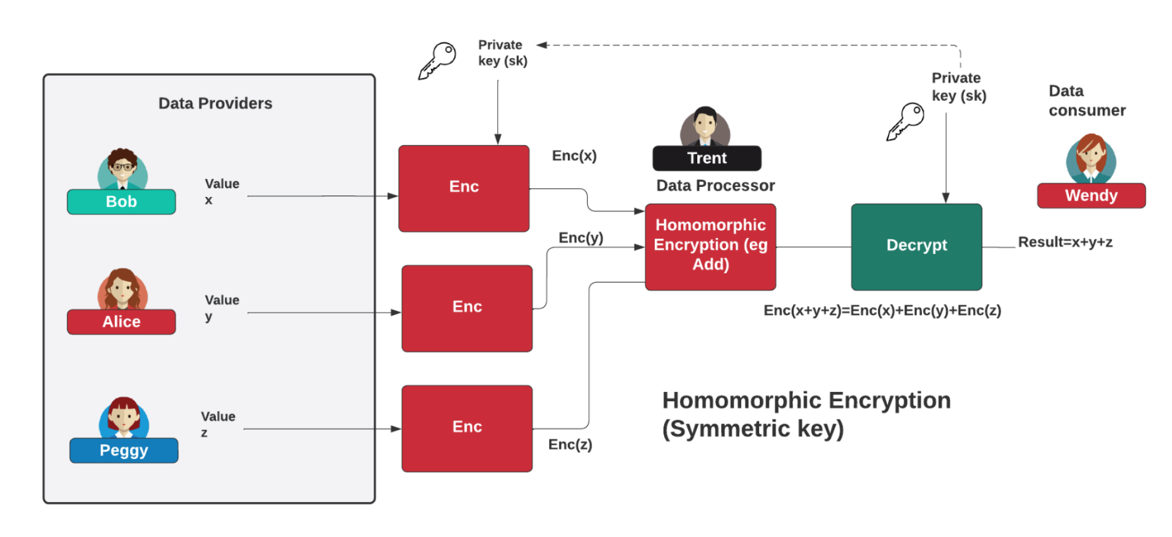
FHE

Slide 8
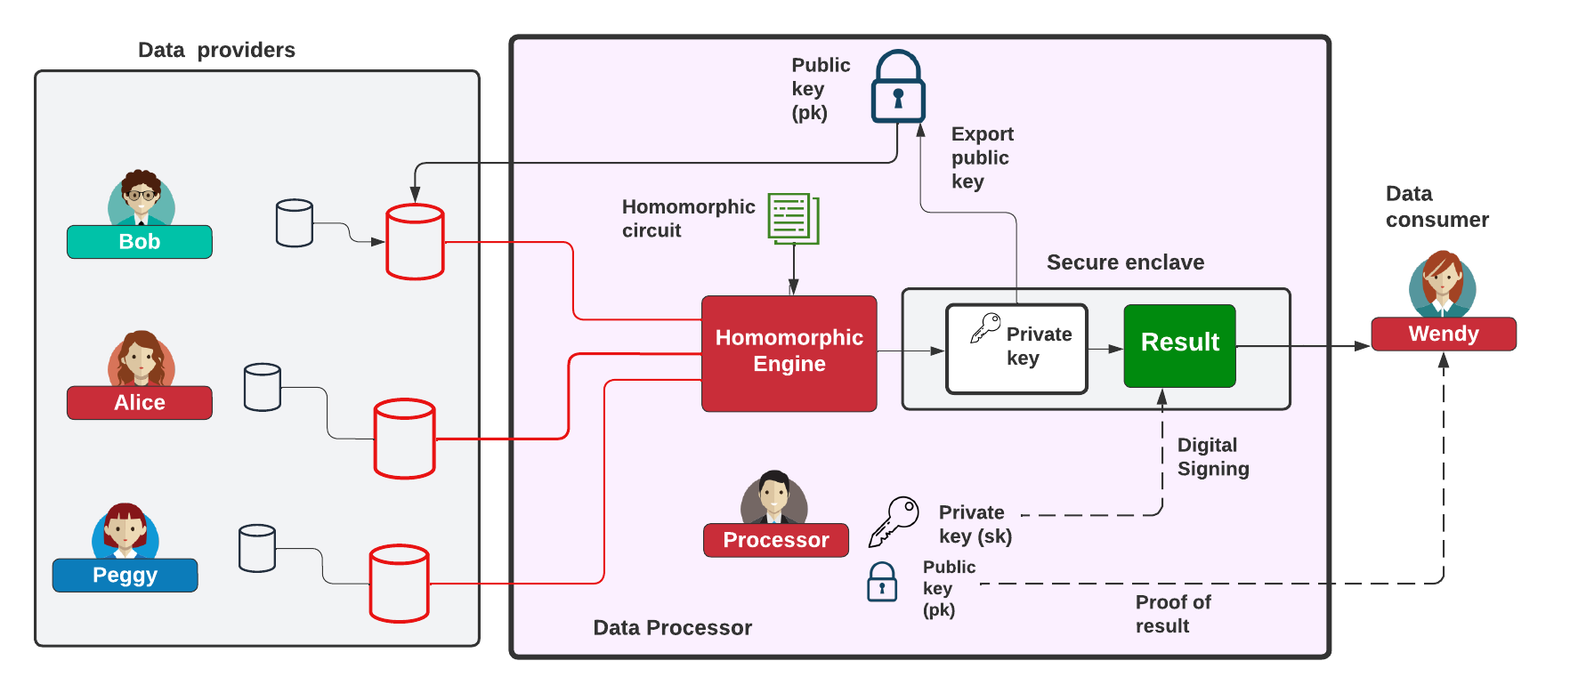

Homomorphic Processing

Slide 9
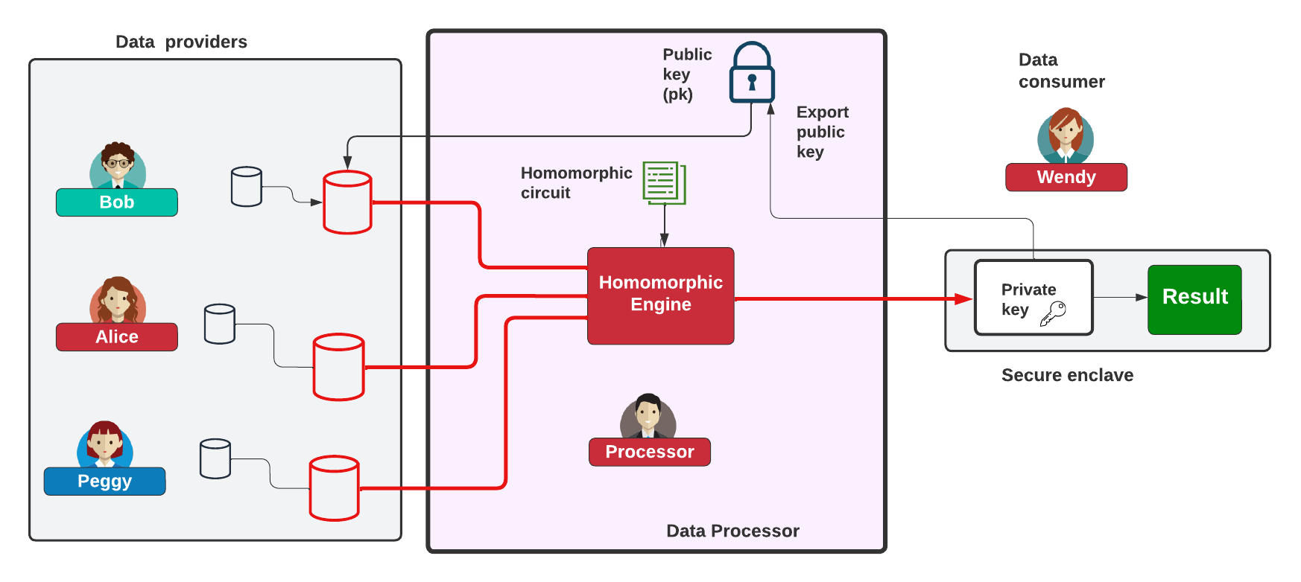
Homomorphic Processing

Slide 10
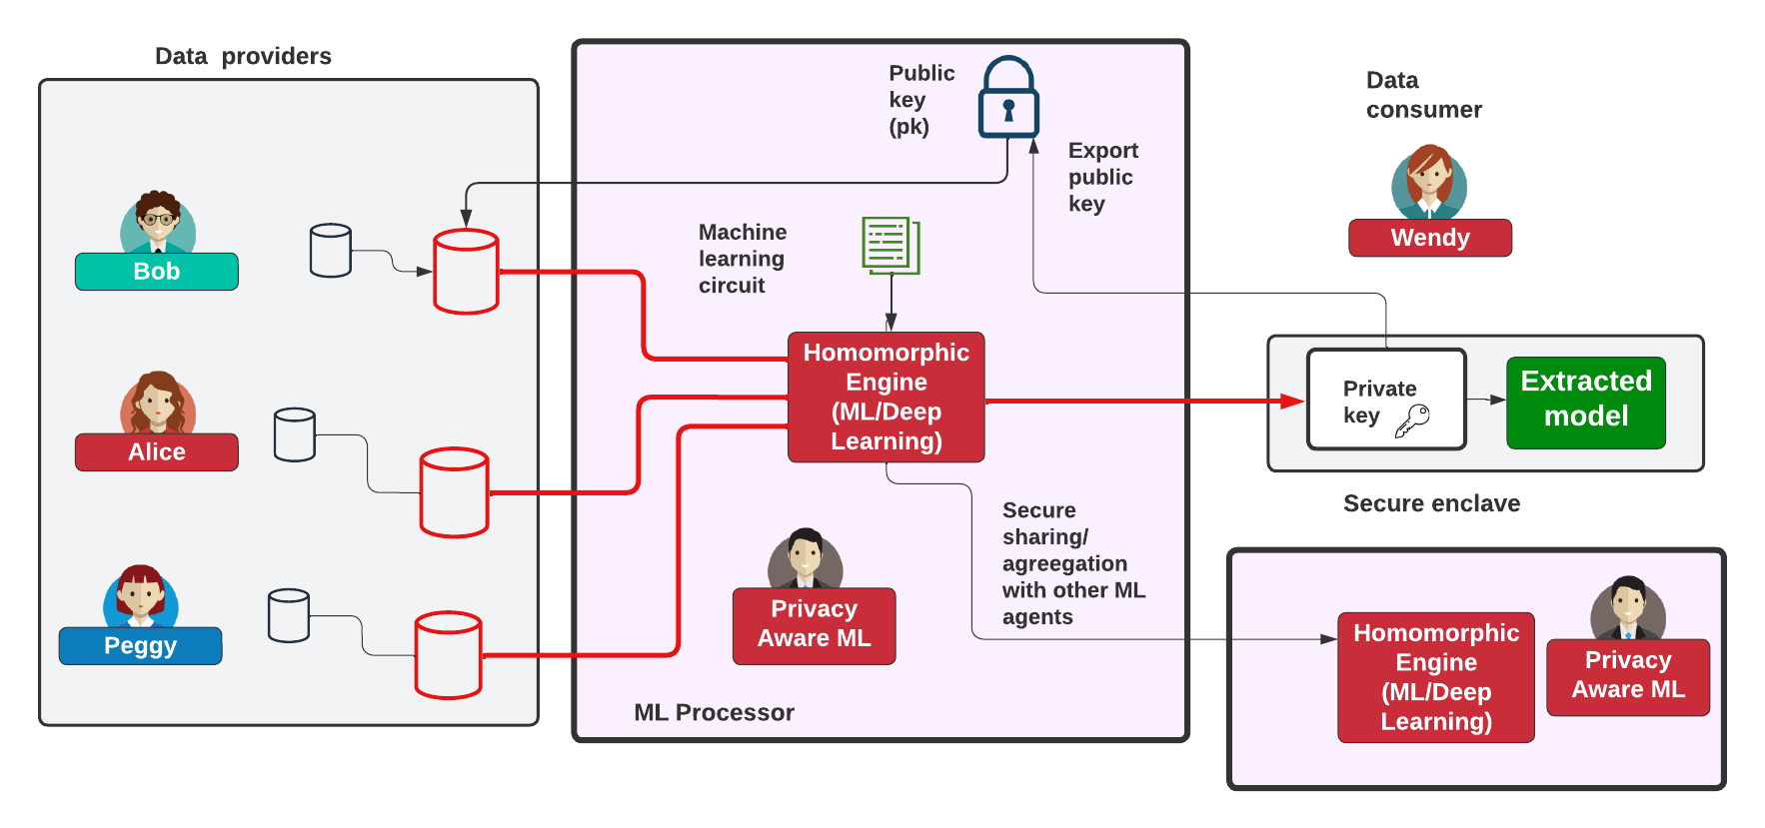
Homomorphic ML

Slide 11
Cryptography: 3. State-of-the-art
Prof Bill Buchanan OBE, Blockpass ID Lab
http://asecuritysite.com

Slide 12
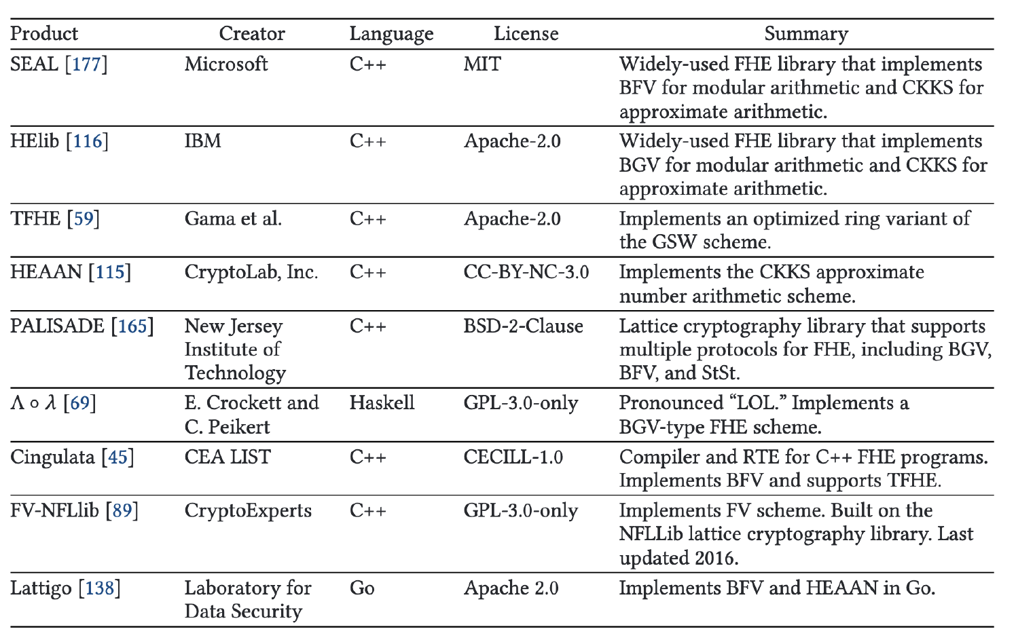
Libraries
OpenFHE

Slide 13
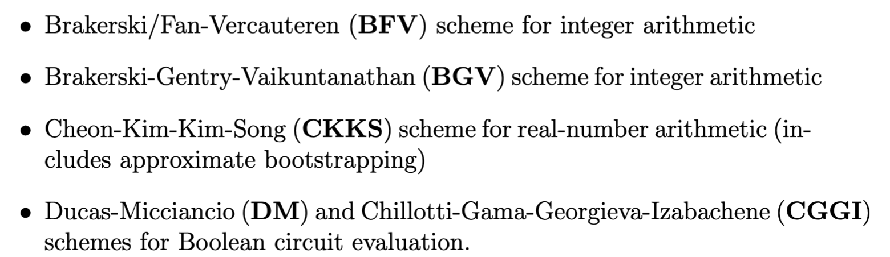
OpenFHE

Slide 14
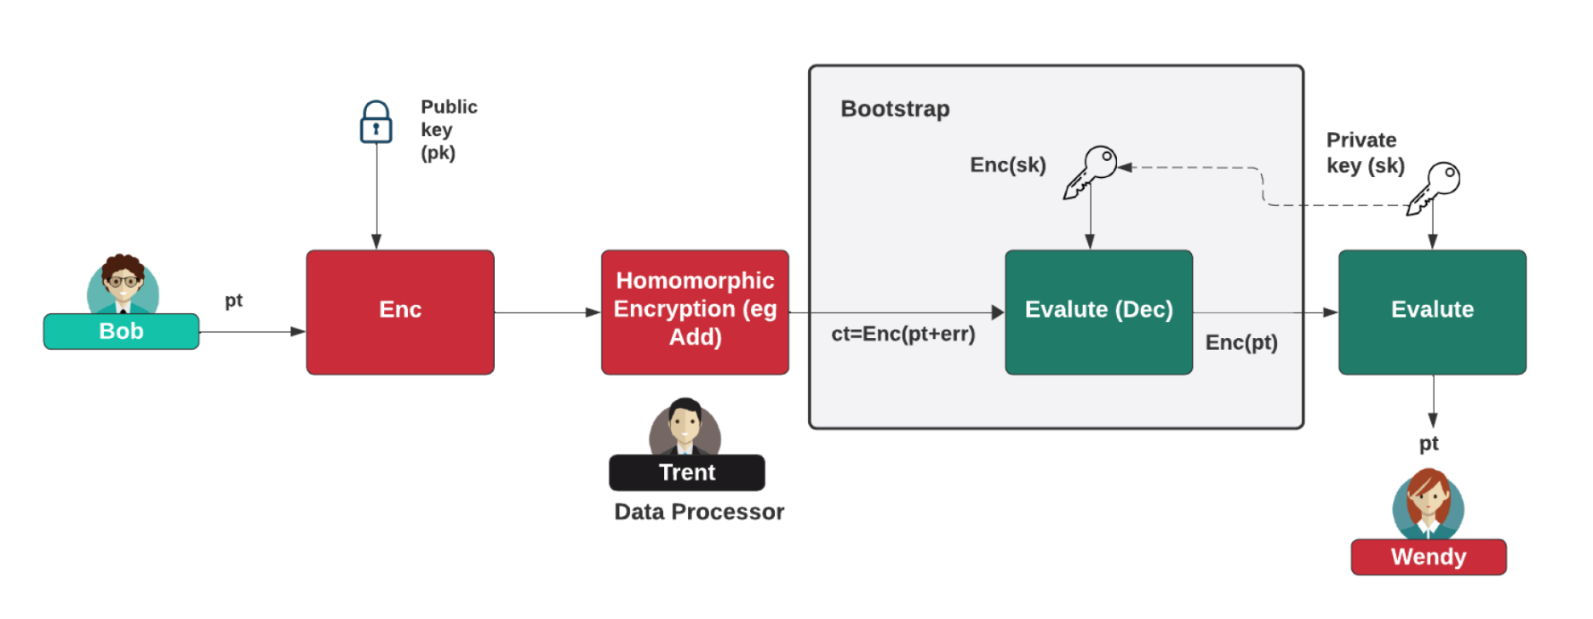
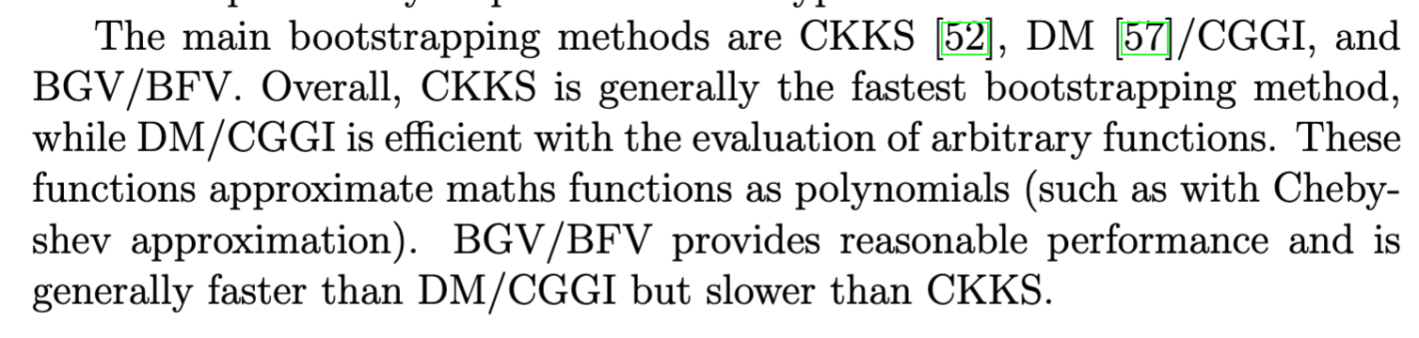
Bootstrapping

Slide 15

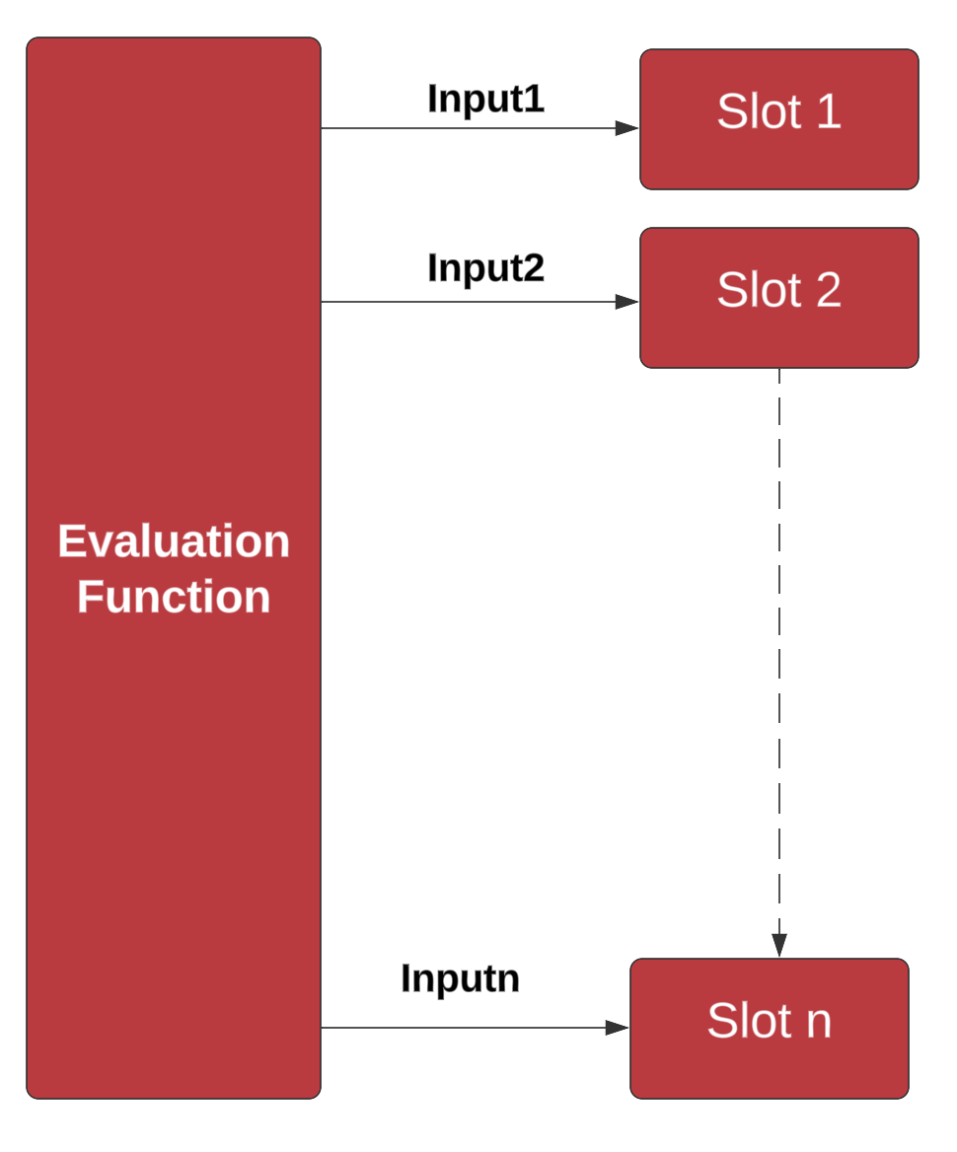
Bootstrapping and Slots
Each ciphertext can have an associated "level" and a value of "noise".
We have various levels. One multiplication consumes a level, and adds noise.
When we reach zero or the noise level is too high, we need to bootstrap - raises the level and reduce noise.

Slide 16
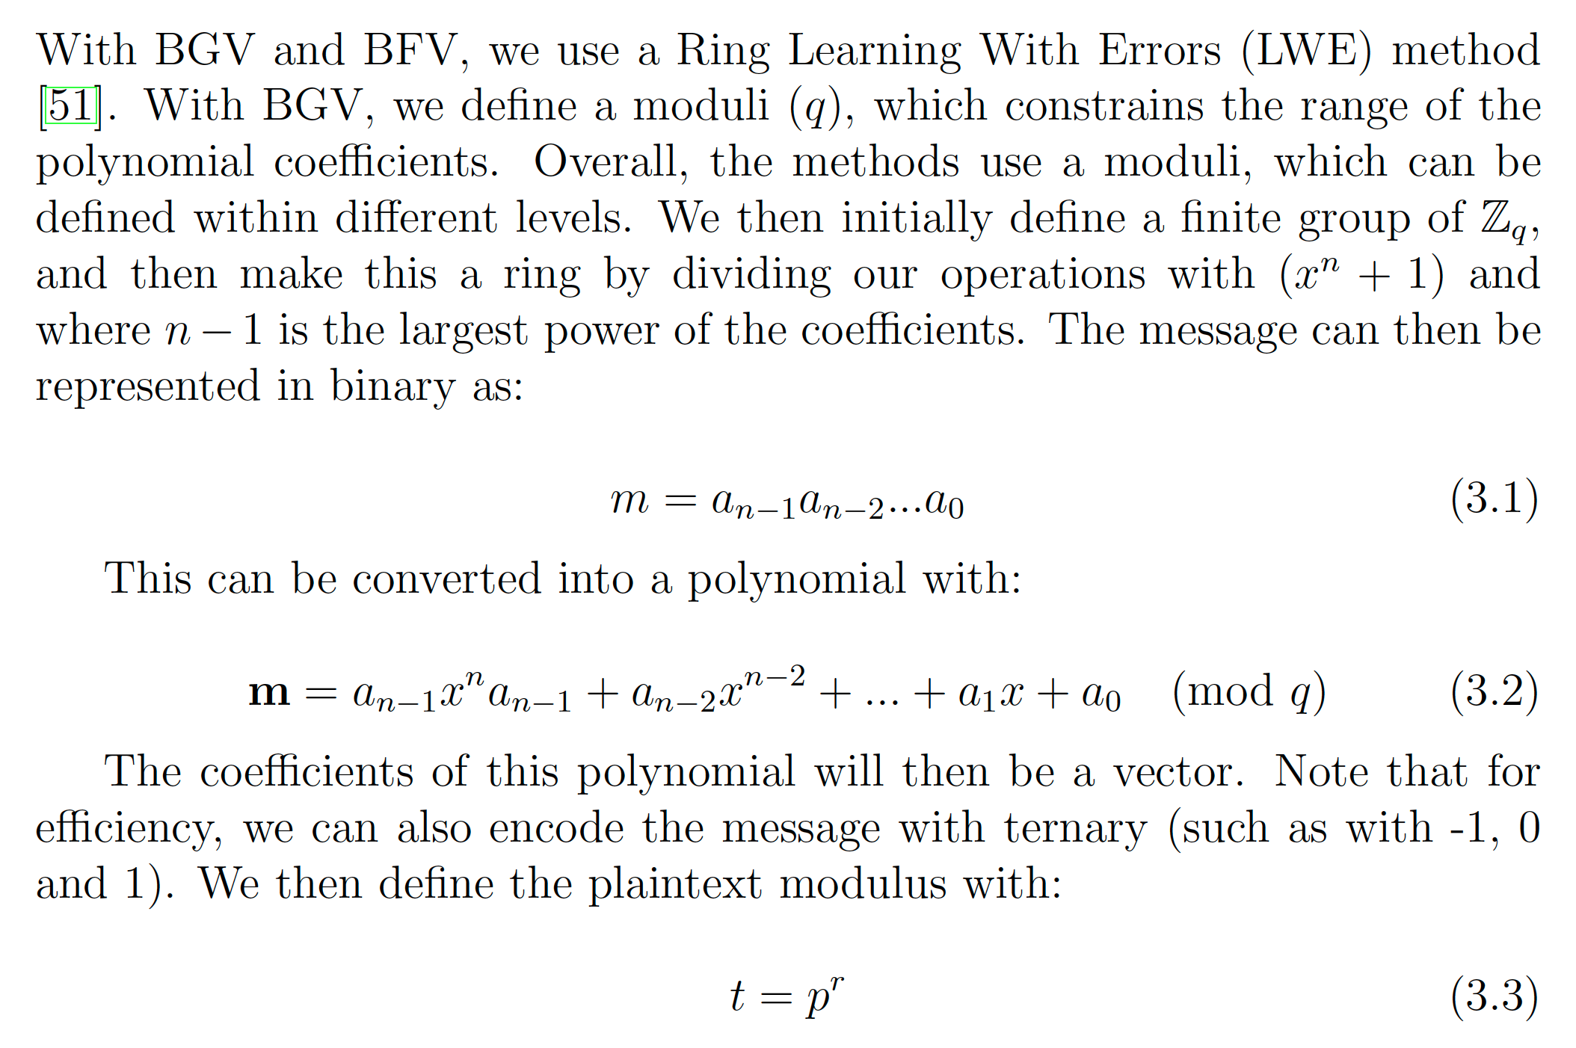
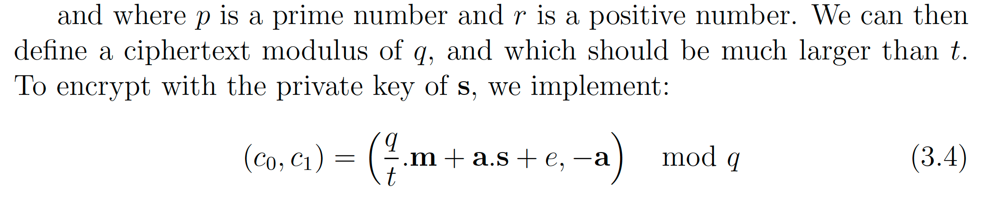
BGV/BFV

Slide 17
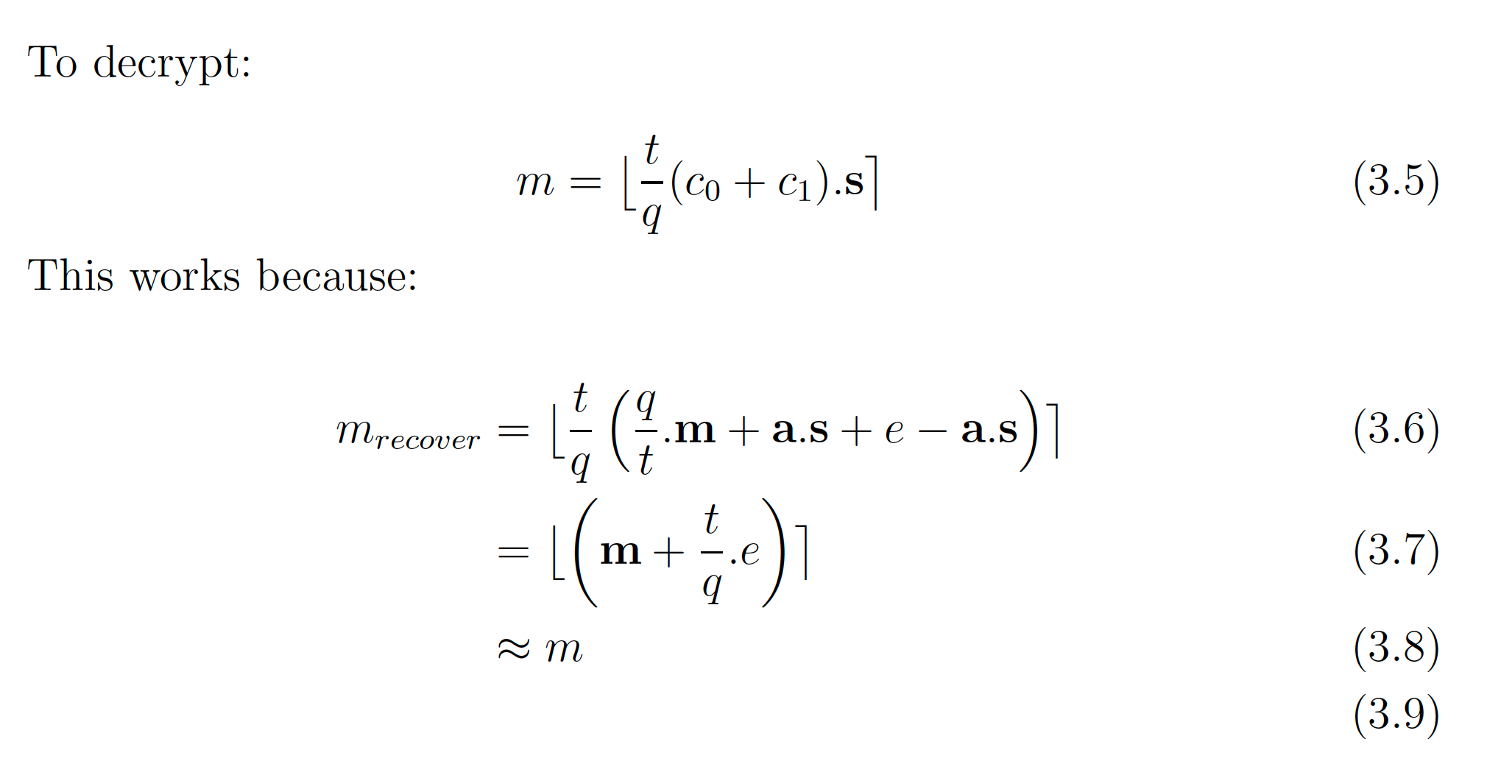
BGV/BFV

Slide 18
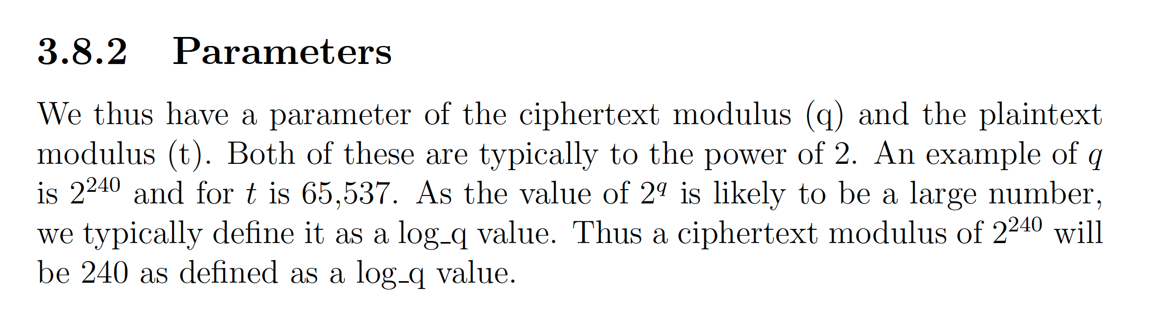
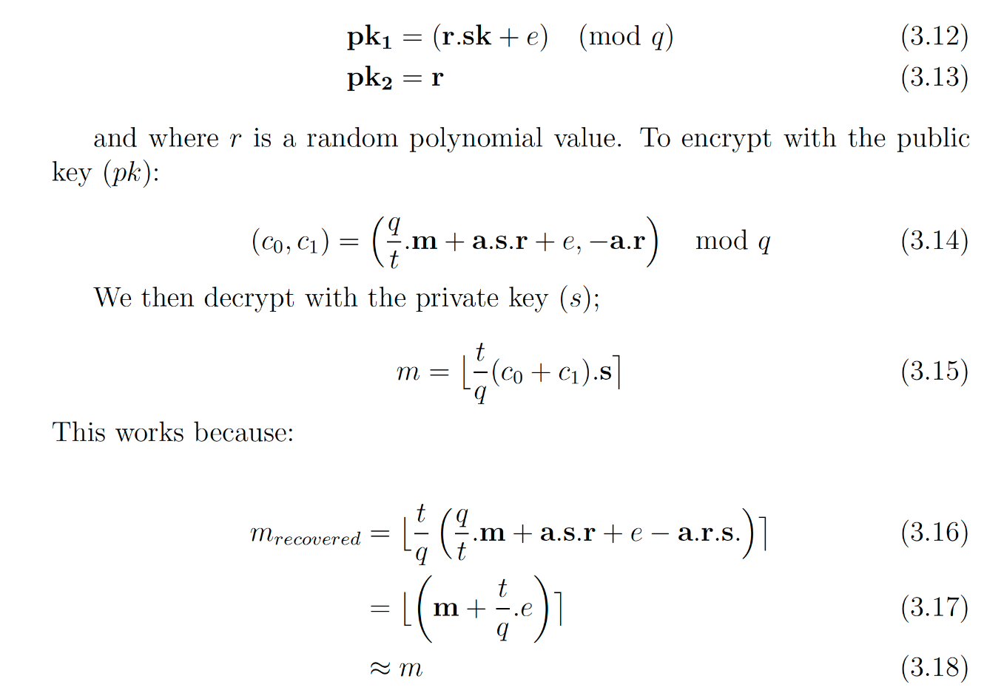
Parameters and Public Key

Slide 19
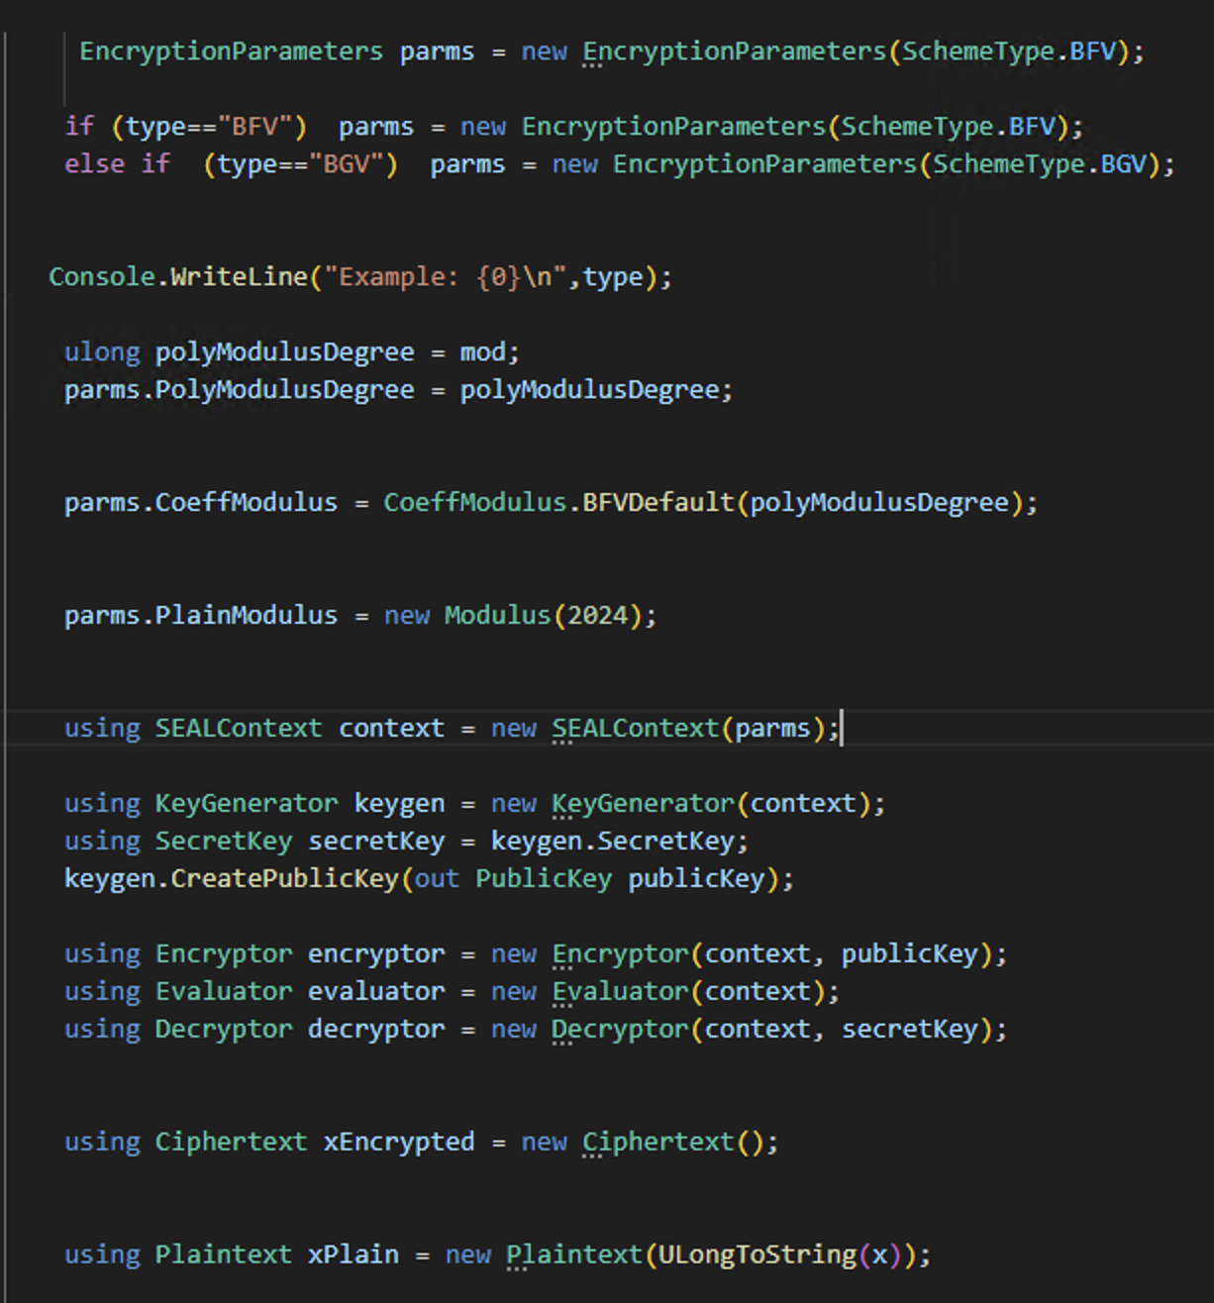

SEAL BFV/BGV
PolyModulusDegree: Defines number of coefficients in plaintext polynomials and the size of ciphertext elements. Must be a power of 2 (such as 1024, 2048, 4096, 8192, 16384, or 32768). Affects performance)
PlainModulus: Largest coefficient that plaintext polynomials can represent. Affects performance.
Add
Plaintext
Plaintext
Square
Encryptor
Evaluator
Decryptor
Ciphertext
Ciphertext

Slide 20
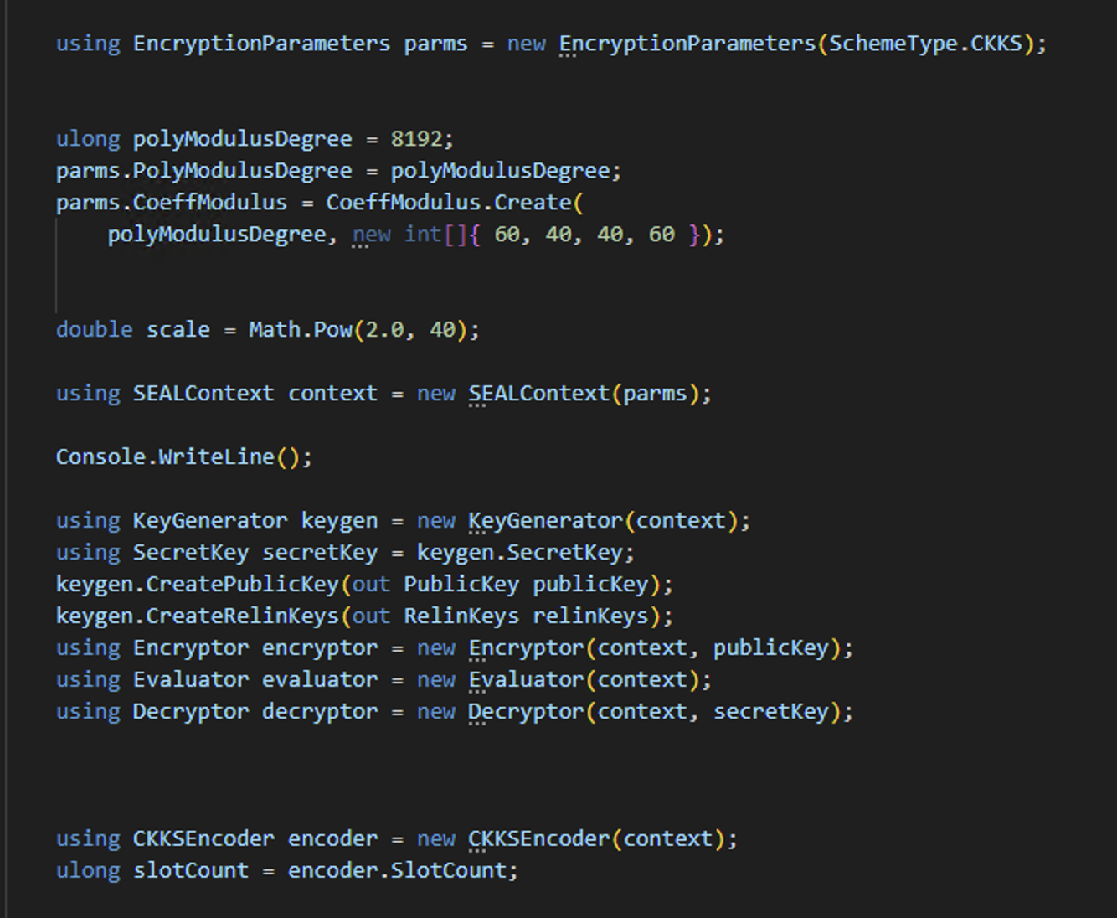
SEAL CKKS
PolyModulusDegree: Defines number of coefficients in plaintext polynomials and the size of ciphertext elements. Must be a power of 2 (such as 1024, 2048, 4096, 8192, 16384, or 32768). Affects performance)
Add
Plaintext
Plaintext
Square
Encryptor
Evaluator
Decryptor
Ciphertext
Ciphertext

Slide 21
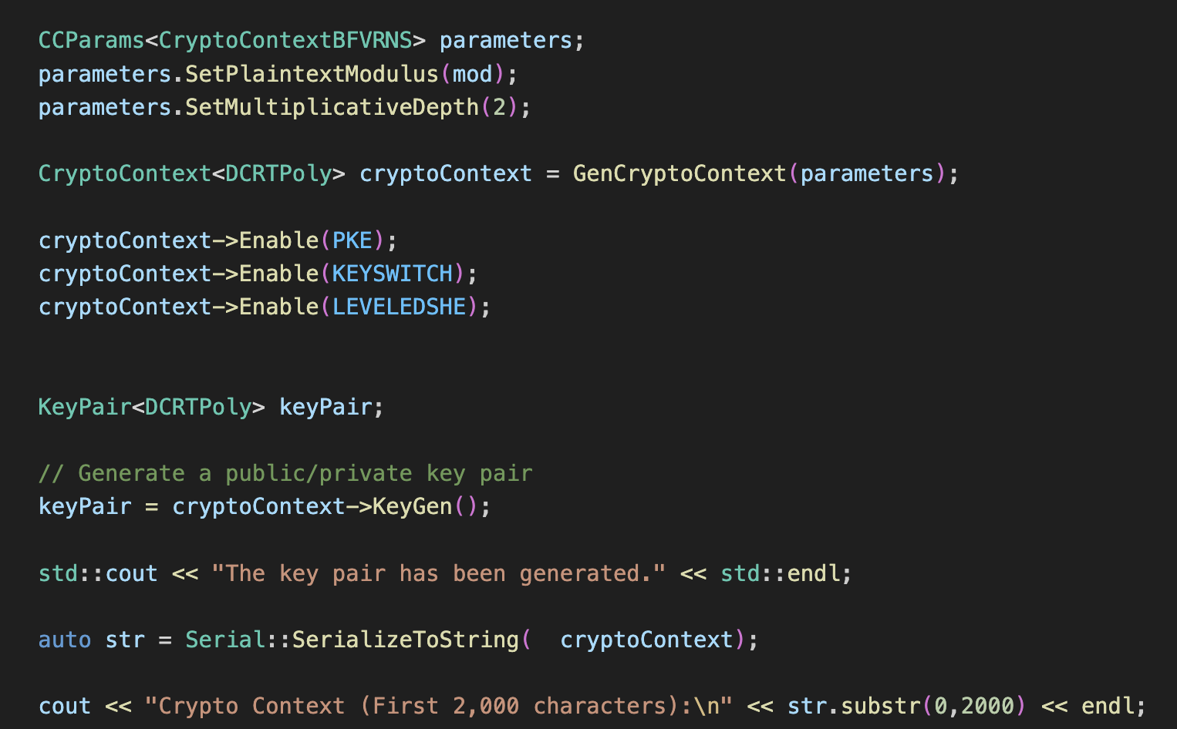
CryptoContext and Parameters (BFV)
Plaintext Modulus
Multiplicative Depth
PKE Scheme Features
Generate key pair (sk, pk)
https://asecuritysite.com/openfhe/openfhe_00cpp

Slide 22

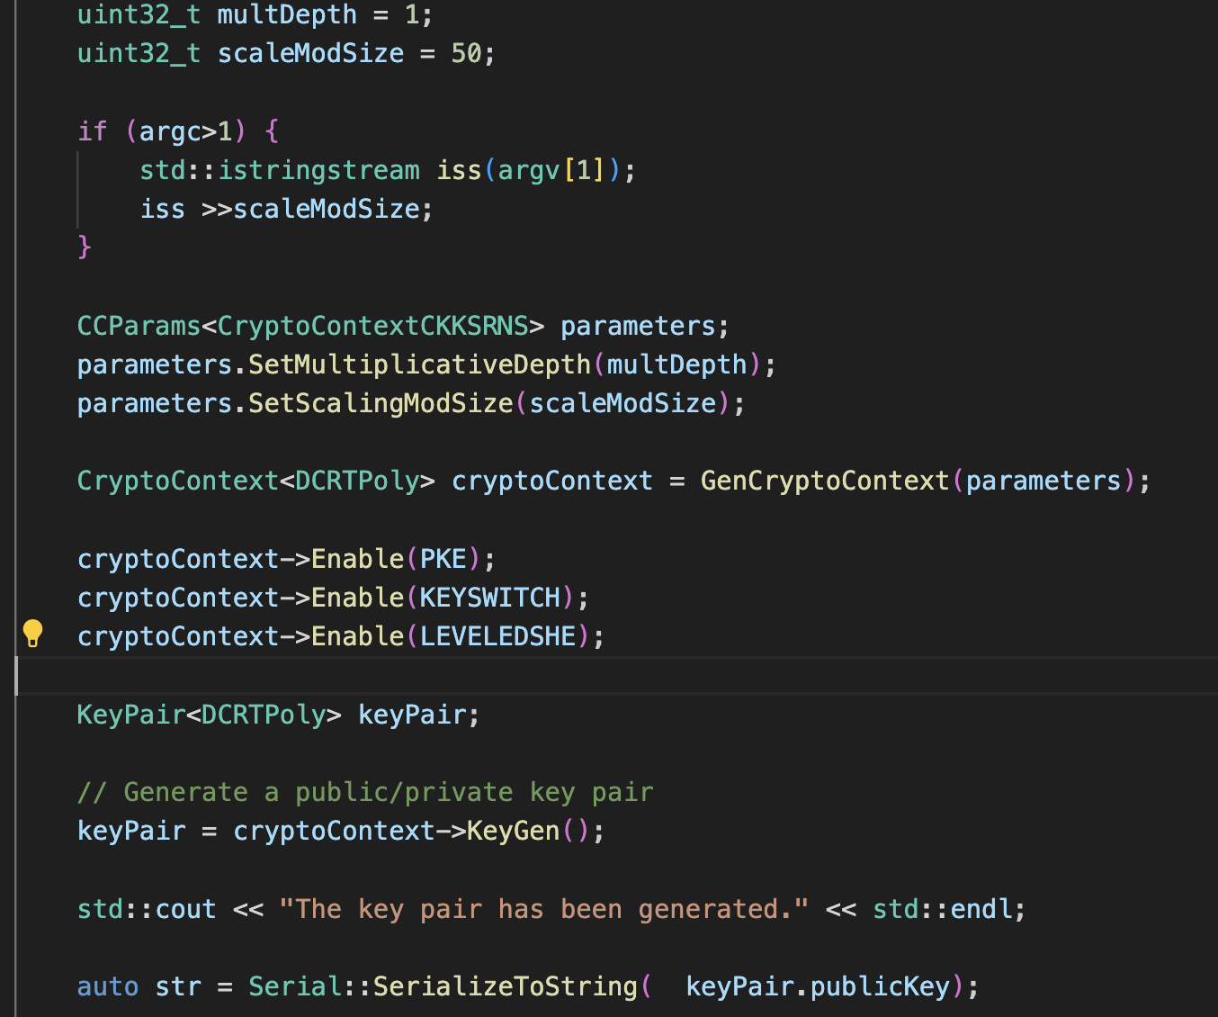
CryptoContext and Parameters (CKKS)
Multiplication depth
Scale Mod Size
https://asecuritysite.com/openfhe/openfhe_00cpp_ckks

Slide 23
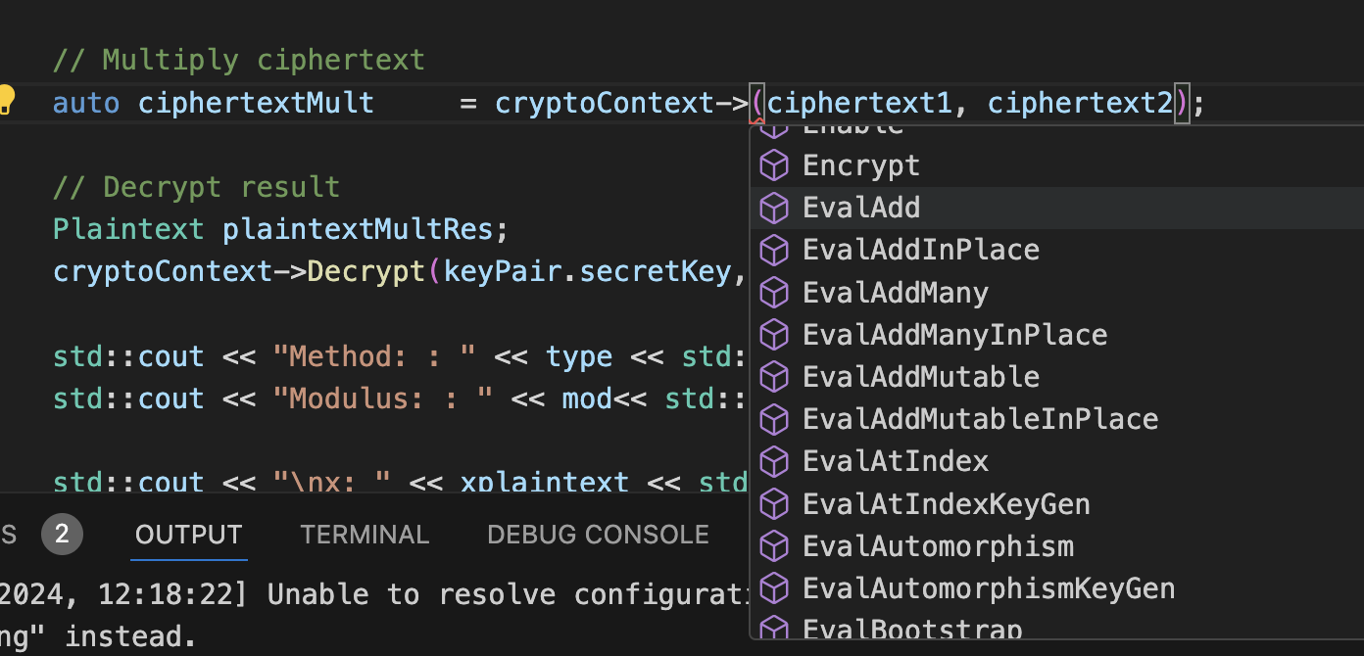
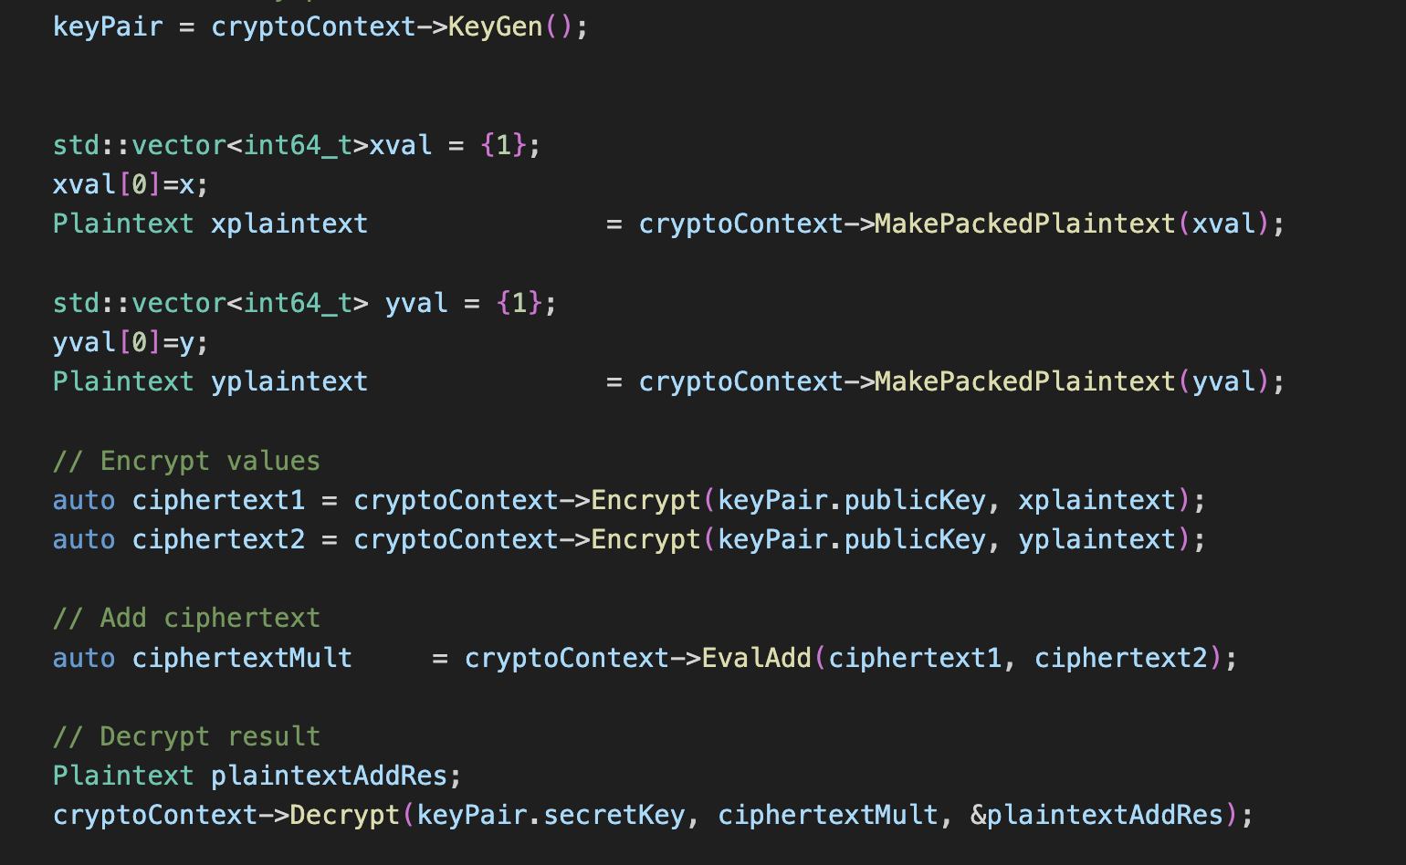
BFV - Adding/Multiplying Two Numbers
https://asecuritysite.com/openfhe/openfhe_02cpp

Slide 24

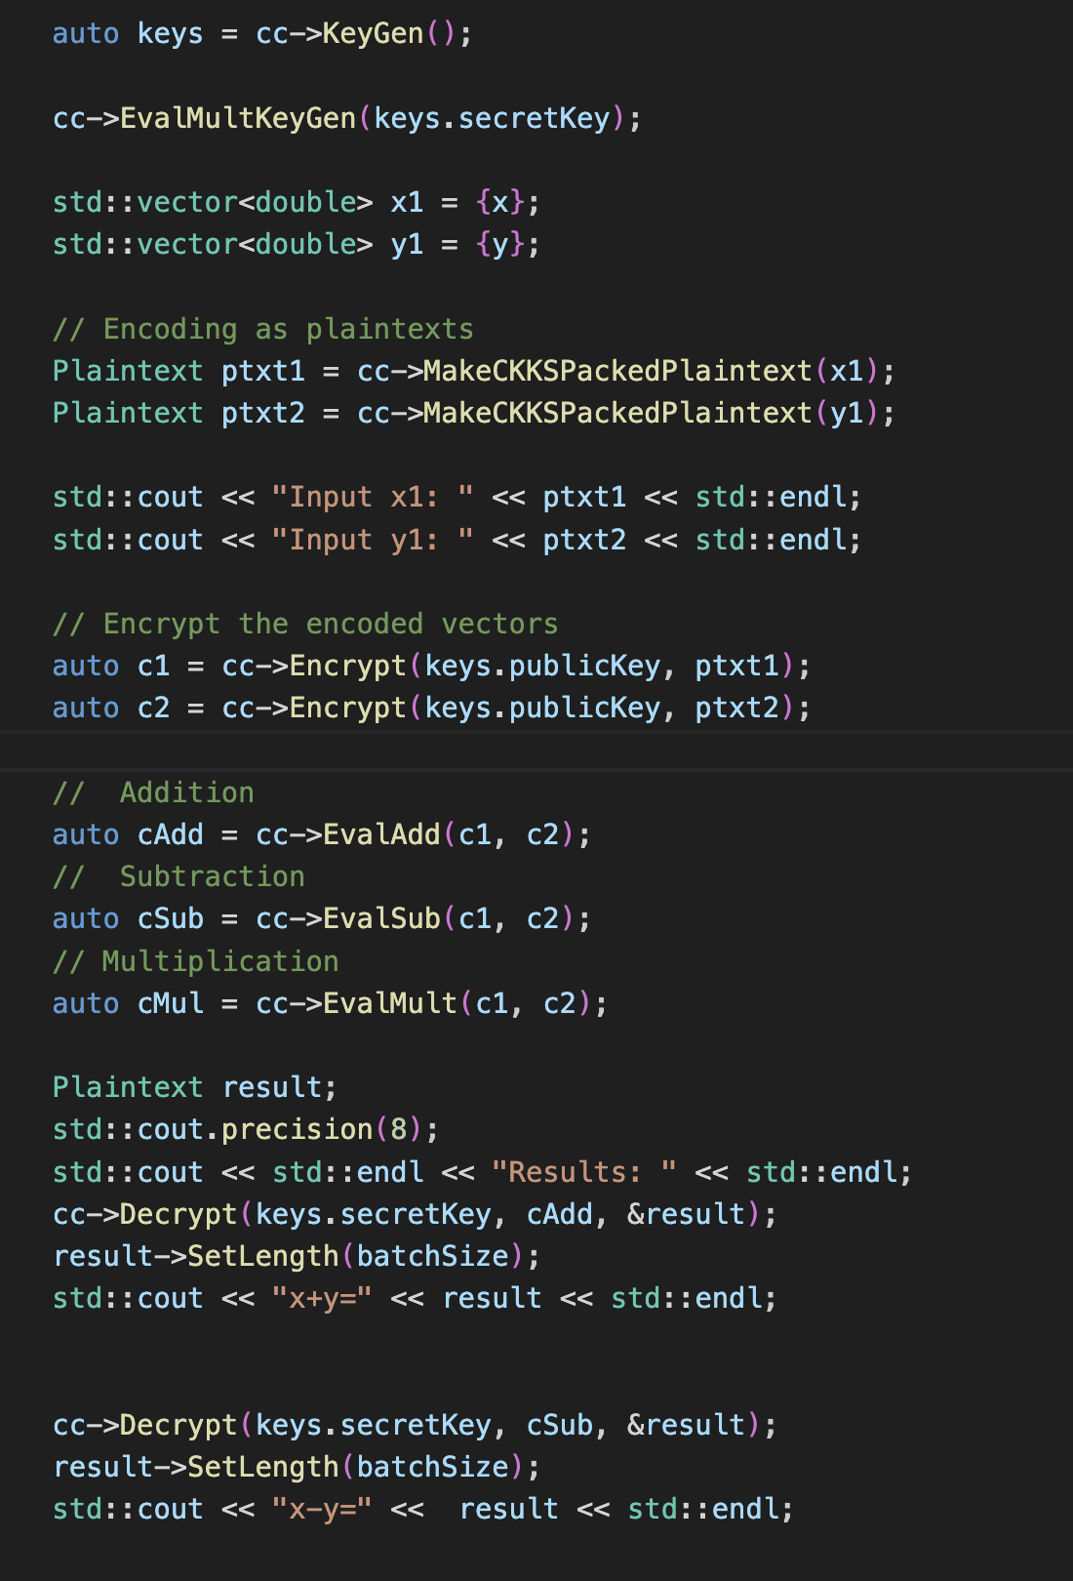
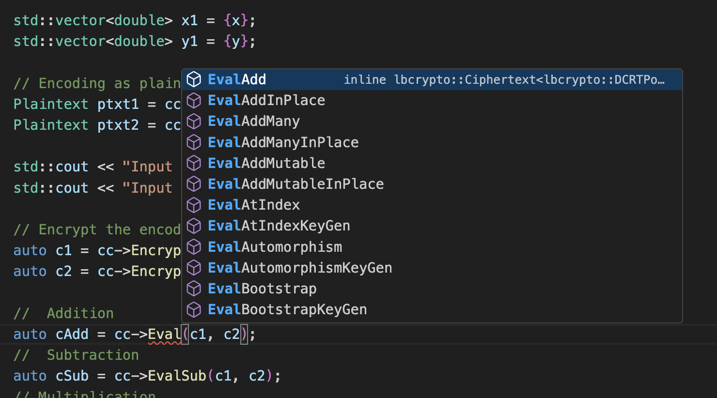
CCKS - Adding/Multiplying Two Numbers
https://asecuritysite.com/openfhe/openfhe_05cpp

Slide 25

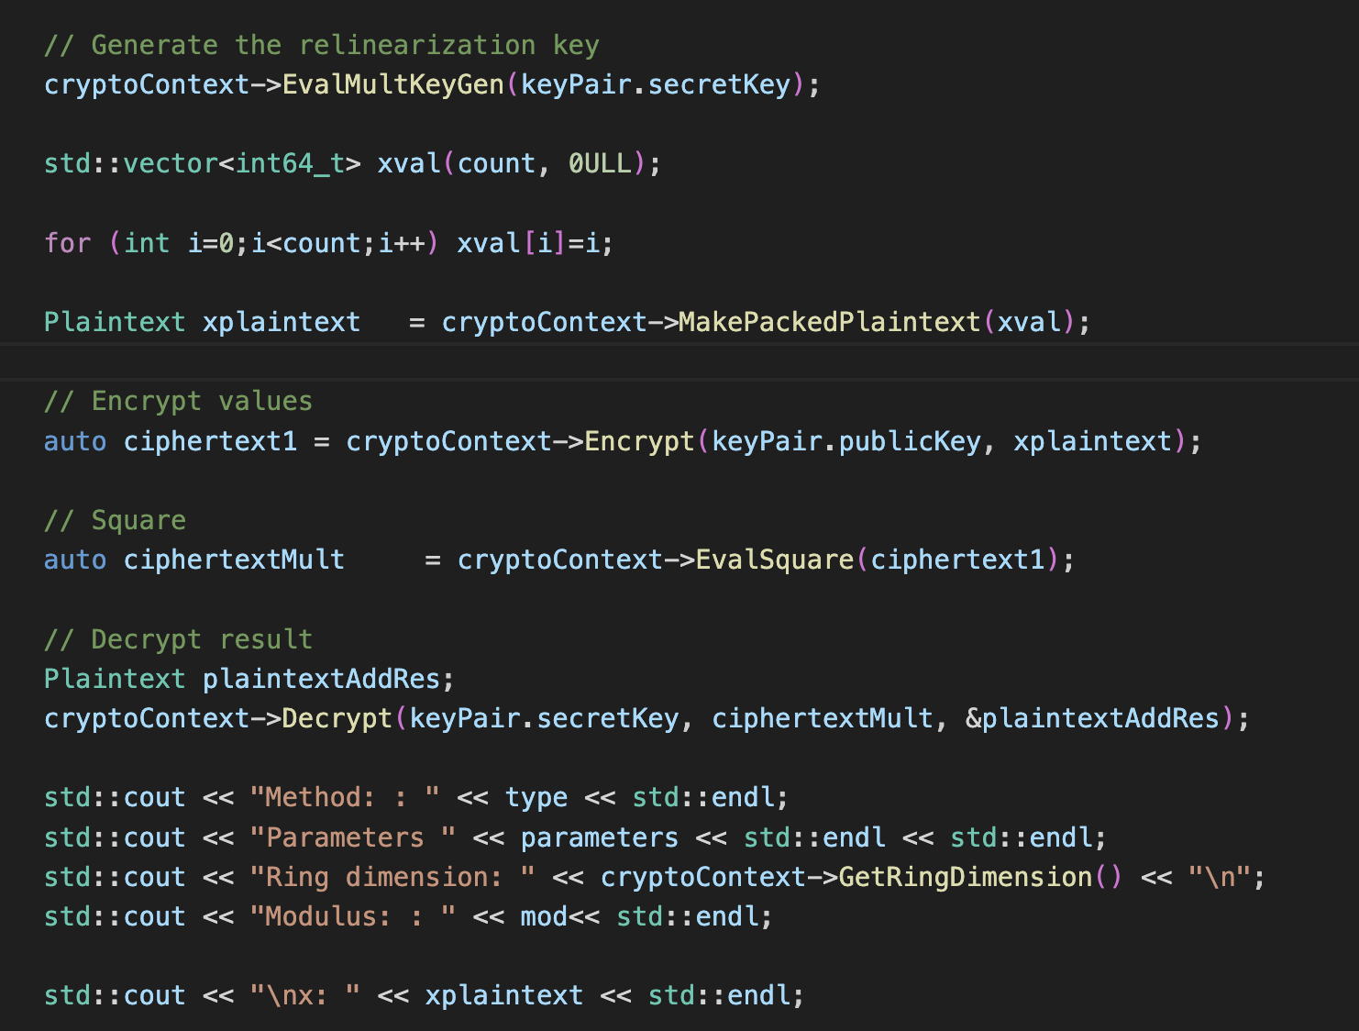
BFV - Batch Processing
https://asecuritysite.com/openfhe/openfhe_08cpp

Slide 26

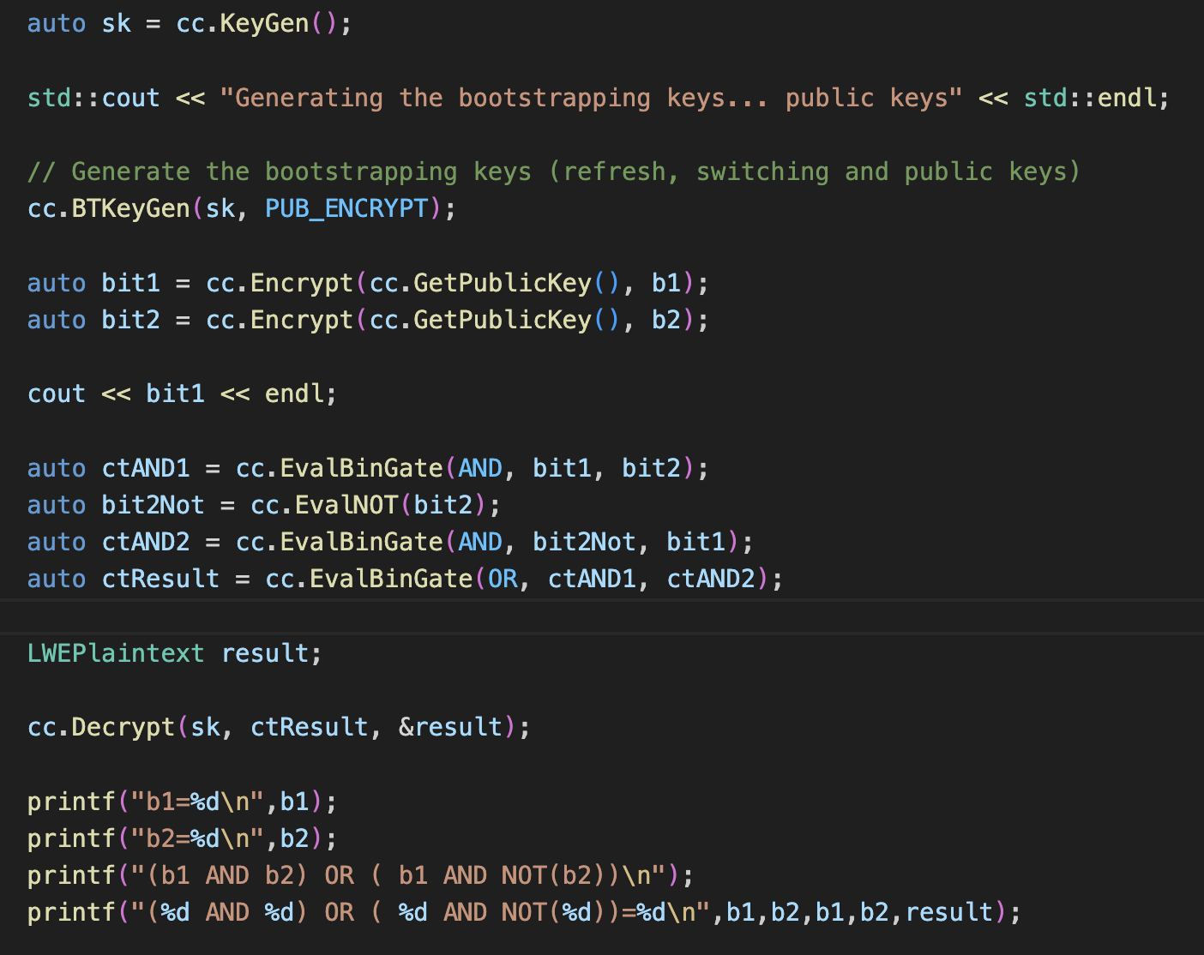

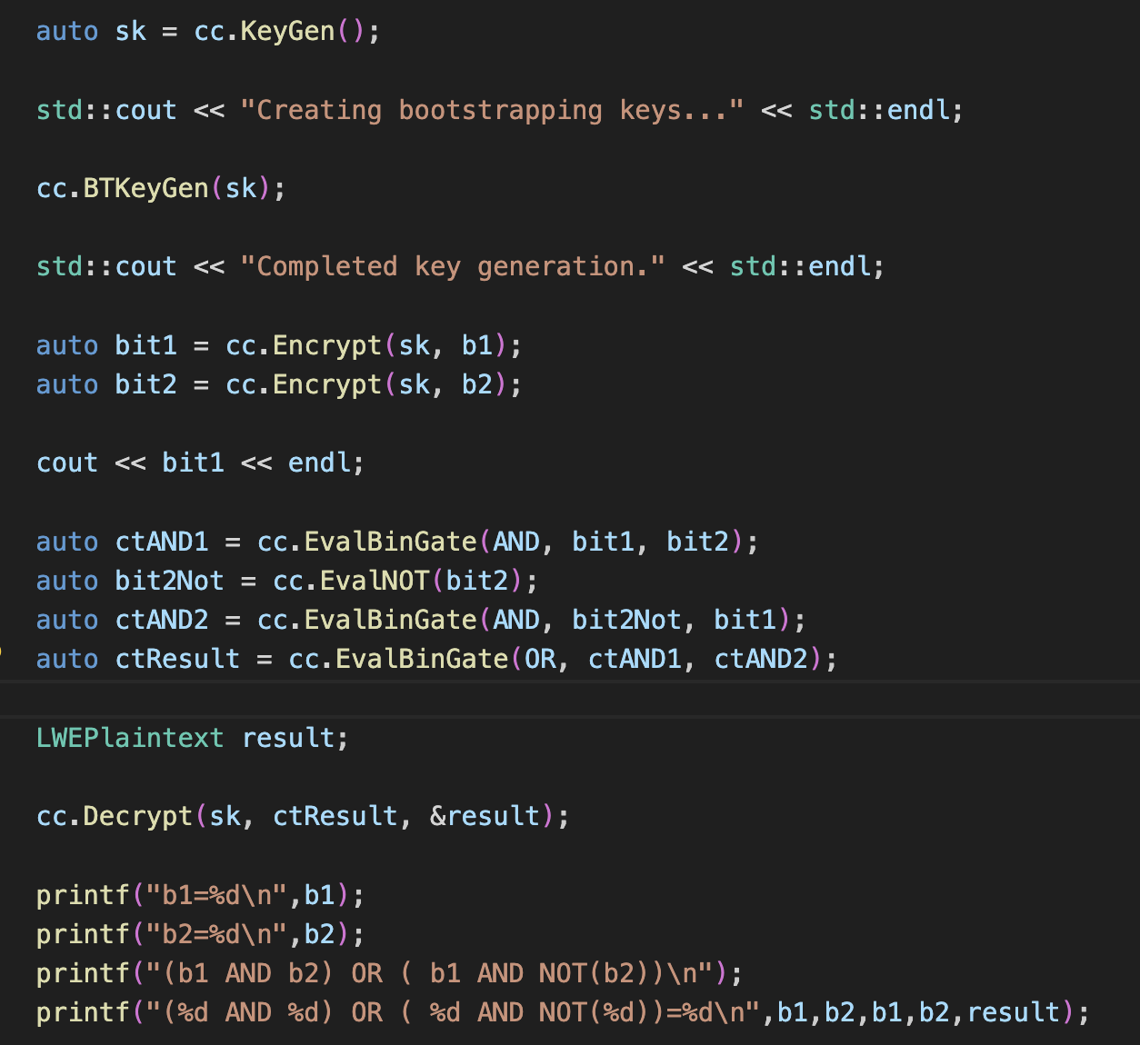
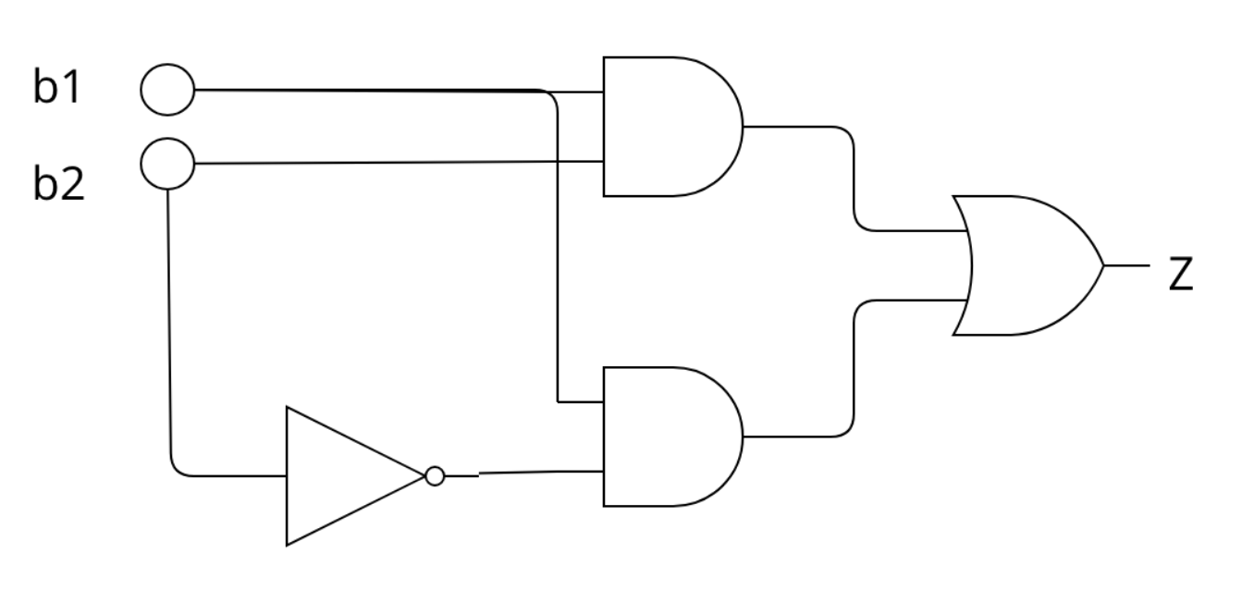
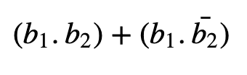
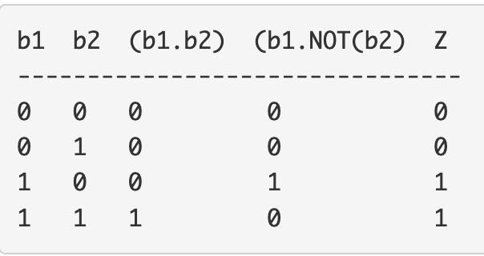
MD/FHEW
https://asecuritysite.com/openfhe/openfhe_09cpp
https://asecuritysite.com/openfhe/openfhe_09cpp_pke

Slide 27

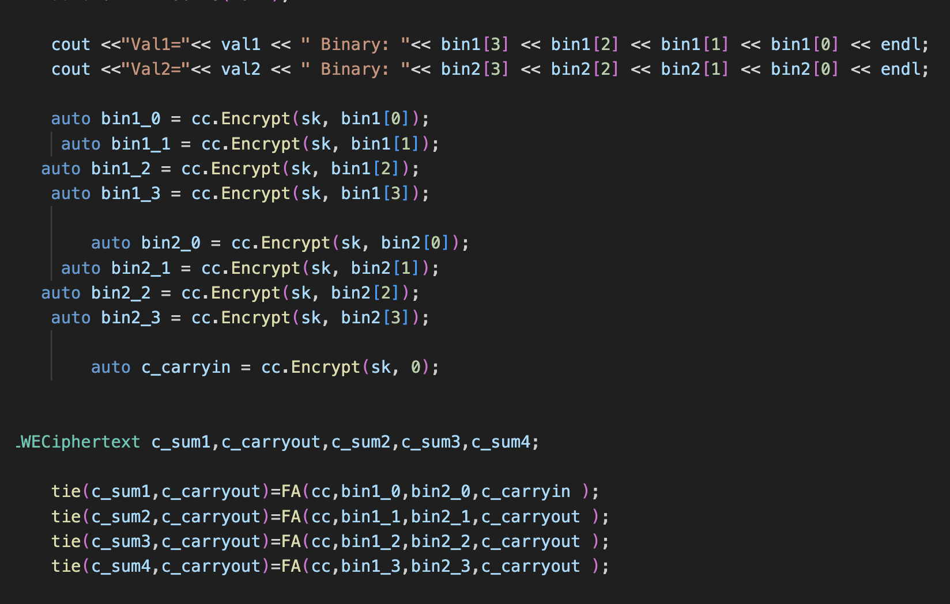
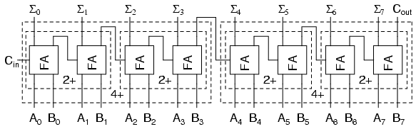
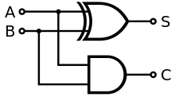
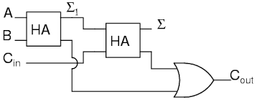
MD/FHEW
https://asecuritysite.com/openfhe/openfhe_11cpp
https://asecuritysite.com/openfhe/openfhe_11cpp_pke

Slide 28

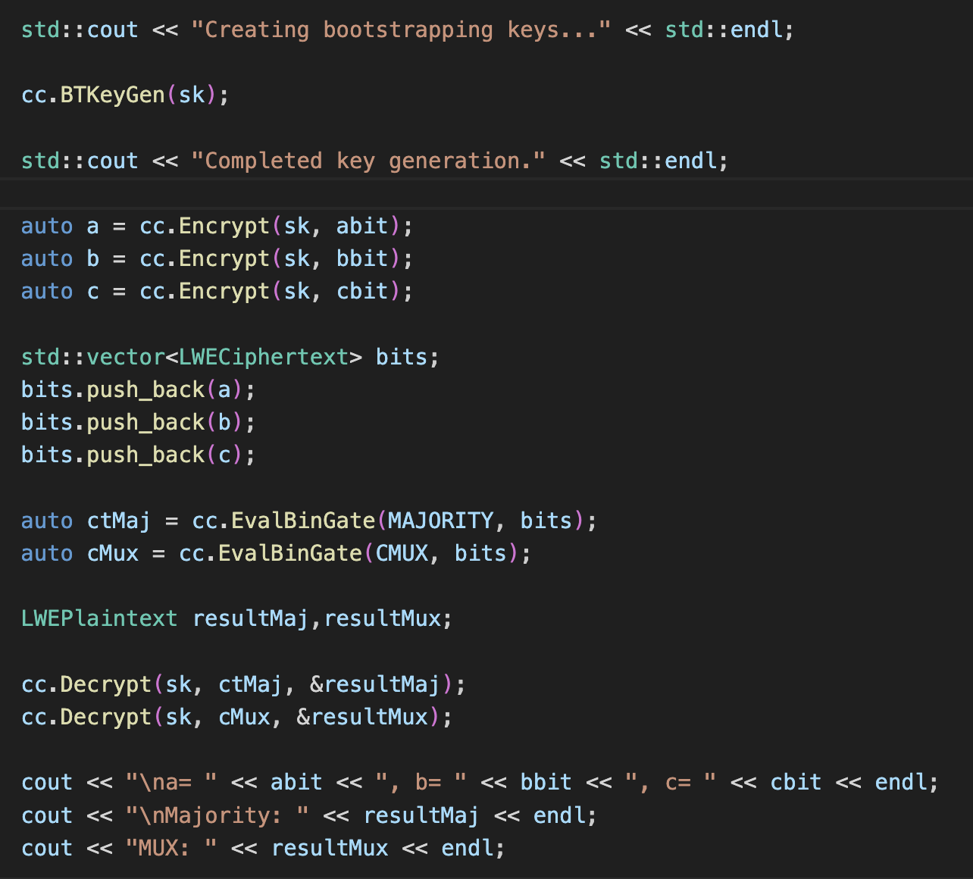


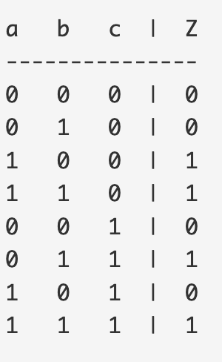
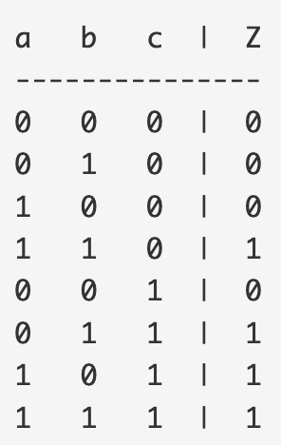
MD/FHEW - MUX and Majority
https://asecuritysite.com/openfhe/openfhe_11cpp
https://asecuritysite.com/openfhe/openfhe_11cpp_pke

Slide 29

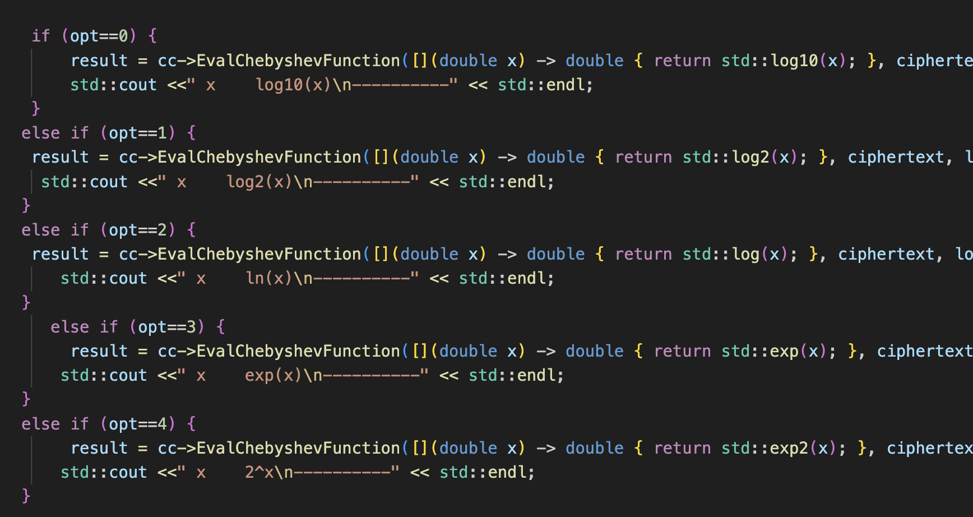
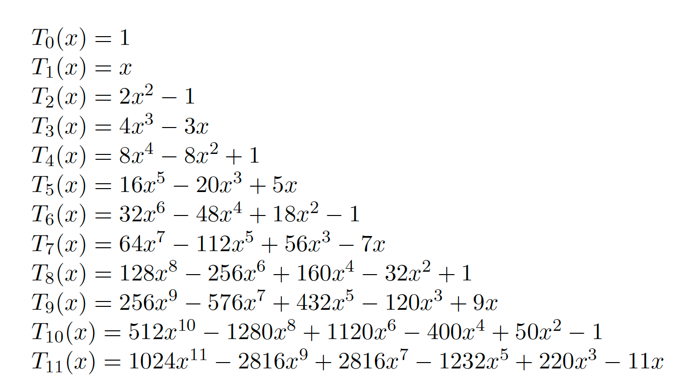
Chebyshev Functions
With approximation theory, it is possible to determine an approximate polynomial p(x)
that is approximate to a function f(x).
https://asecuritysite.com/openfhe/openfhe_18cpp

Slide 30
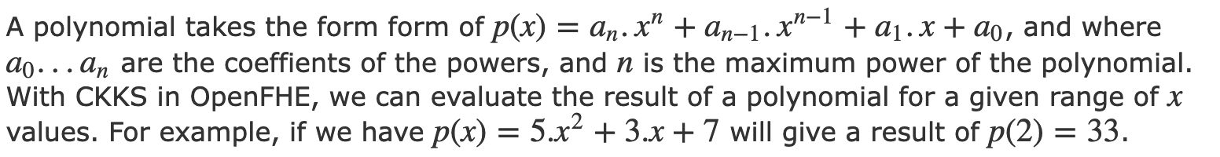

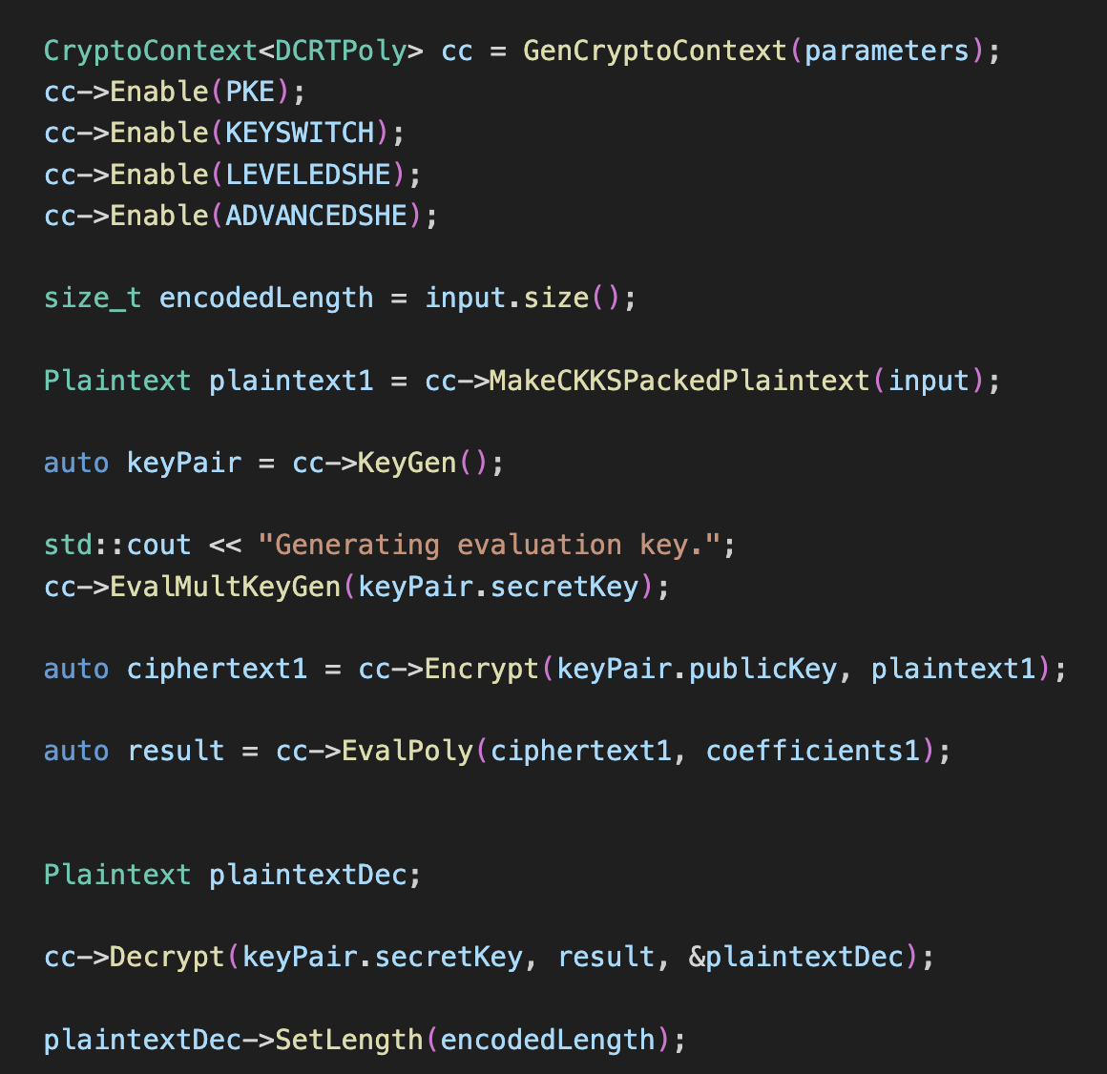
Polynomial Evaluation
https://asecuritysite.com/openfhe/openfhe_20cpp

Slide 31
FHE: 4. Data Sharing
Prof Bill Buchanan OBE, Blockpass ID Lab
http://asecuritysite.com

Slide 32
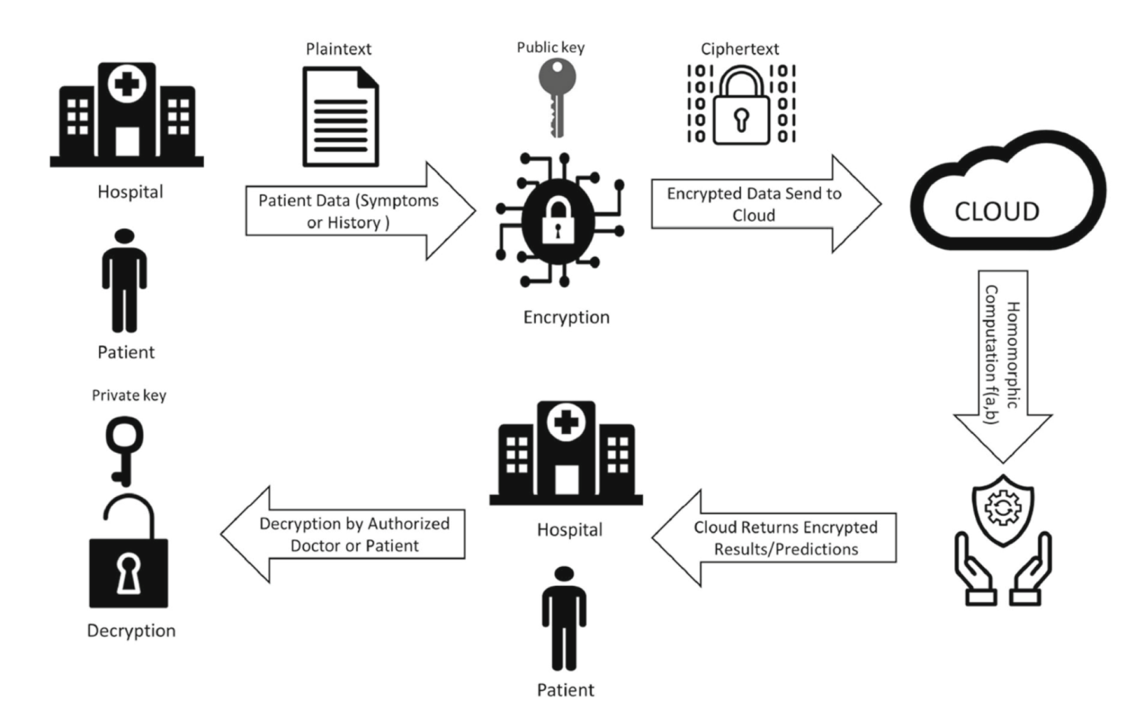
Homomorphic Sharing

Slide 33
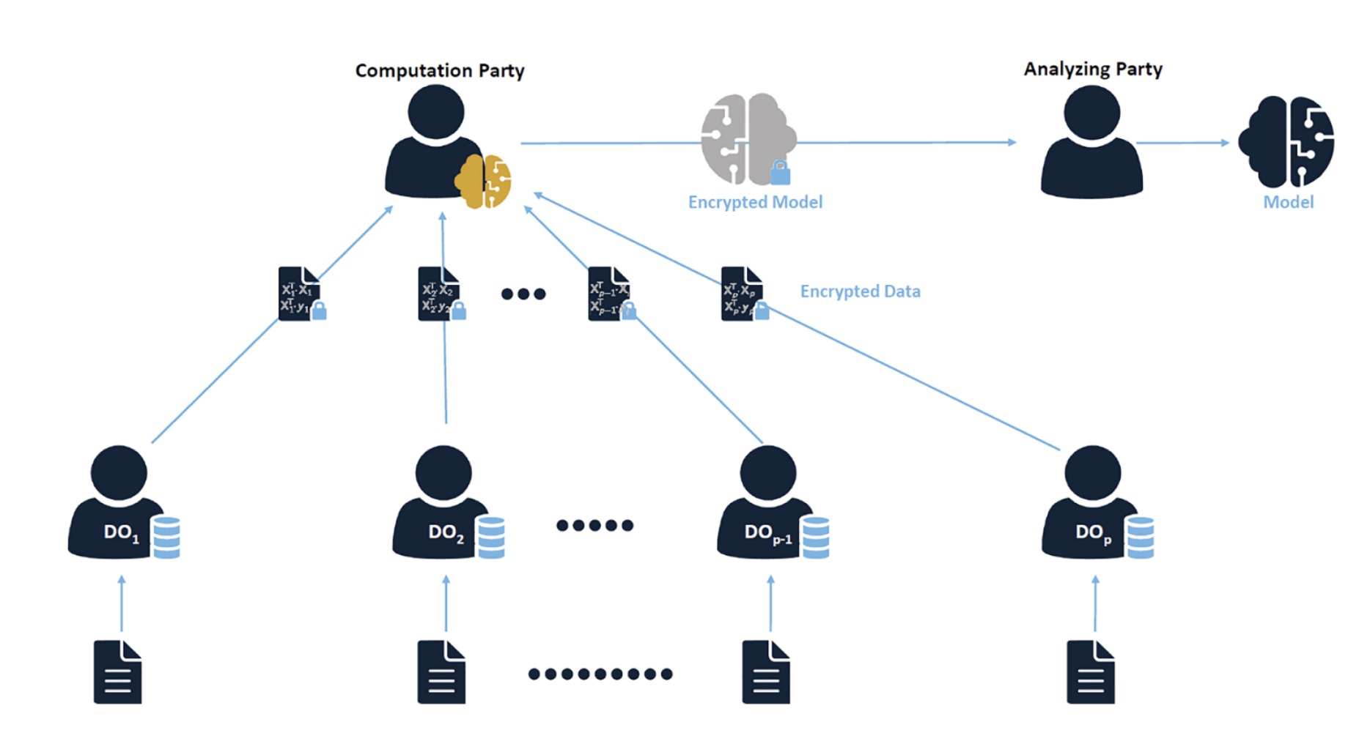
Multiparty Sharing

Slide 34

SmartCrypt

Slide 35

Using Symmetric Key for HE

Slide 36




Proxy Re-encryption (PRE)
https://asecuritysite.com/openfhe/openfhe_21cpp

Slide 37
FHE: 5. Cloud
Prof Bill Buchanan OBE, Blockpass ID Lab
http://asecuritysite.com

Slide 38


Symmetric/Asymmetric in Cloud

Slide 39


Searchable Encryption

Slide 40



Location Tracking

Slide 41

Privacy-aware biometrics/ID

Slide 42


Apple Privacy Aware

Slide 43
FHE: 6. MPC
Prof Bill Buchanan OBE, Blockpass ID Lab
http://asecuritysite.com

Slide 44




Threshold Encryption
https://asecuritysite.com/openfhe/openfhe_16cpp
https://asecuritysite.com/openfhe/openfhe_17cpp

Slide 45
FHE: 7. ML
Prof Bill Buchanan OBE, Blockpass ID Lab
http://asecuritysite.com

Slide 46



Matrix Operations

Slide 47

Private Prediction as a Service
[87] M. Iezzi, “Practical privacy-preserving data science with homomorphic encryption: an overview,” in 2020 IEEE International Conference on Big Data (Big Data). IEEE, 2020, pp. 3979–3988.

Slide 48





Logistic Function
https://asecuritysite.com/openfhe/openfhe_19cpp

Slide 49



Matrix Operations
https://asecuritysite.com/openfhe/openfhe_13cpp
https://asecuritysite.com/openfhe/openfhe_14cpp

Slide 50



Matrix Operations
https://asecuritysite.com/openfhe/openfhe_27cpp

Slide 51




Matrix Operations
https://asecuritysite.com/openfhe/openfhe_27cpp
https://asecuritysite.com/openfhe/openfhe_26cpp

Slide 52


Matrix Operations
https://asecuritysite.com/openfhe/openfhe_27cpp
https://asecuritysite.com/openfhe/openfhe_26cpp

Slide 53



Matrix Operations
https://asecuritysite.com/openfhe/openfhe_28cpp
https://asecuritysite.com/openfhe/openfhe_29cpp

Slide 54


GWAS (Gnome-wide Association Studies)

Slide 55

SVM

Slide 56


Concrete-ML

Slide 57
FHE: 8. Quantum Robust
Prof Bill Buchanan OBE, Blockpass ID Lab
http://asecuritysite.com

Slide 58
Quantum Robust
Existing state-of-the-art gives 105 Qubits (Google Willow). Need millions to crack existing public key methods.
All existing public key methods will be cracked by QC, eg RSA, ECC and ElGamal.
Kyber for Key Exchange/Encryption and Dilithium for Digital Signatures should be used.
LWE is currently a quantum robust method.

Slide 59
FHE: 9. Hardware Requirements
Prof Bill Buchanan OBE, Blockpass ID Lab
http://asecuritysite.com

Slide 60


NTT (Number Theoretic Transform)
Two cipher text values: c1.ax and c2.bx

Slide 61




AVX-512

Slide 62





GPUs (BFV)

Slide 63



Specialist Hardware (F1)

Slide 64

Specialist Hardware (Craterlake)

Slide 65

Specialist Hardware (RPU)

Slide 66
FHE: 10. Data Fragmentation
Prof Bill Buchanan OBE, Blockpass ID Lab
http://asecuritysite.com

Slide 67

Fragmentation

Slide 68
FHE: 11. Side Channel
Prof Bill Buchanan OBE, Blockpass ID Lab
http://asecuritysite.com

Slide 69

TBC

Slide 70


Side-channel

Slide 71


Side-channel

Slide 72


Side-channel

Slide 73


Side-channel (Mitigation)

Slide 74



Side-channel (Mitigation)

